Slide 1
MAASTO Truck Parking Information Management System (TPIMS) Archive
September 2023, OKI Conference on Freight
Mid America Freight Coalition

Slide 2
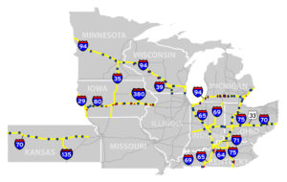


Overview of the TPIMS Project
Transportation Investment Generating Economic Recovery (TIGER) Grant
FHWA and State funds
System was fully operational in January 2019
TIGER grant period ended March, 2022

Slide 3
MAFC’s Role
Archiving Data
- Site Metadata
- Continuous Usage Feed
Log Monitoring
Performance Measures (PMs)
- Downtime
- Utilization
- Accuracy
Web Services (Web portal)
- Data Download
- User Management

Slide 4
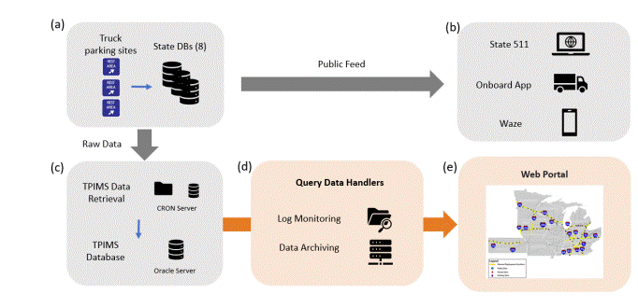
TPIMS System Architecture and Data Flows

Slide 5
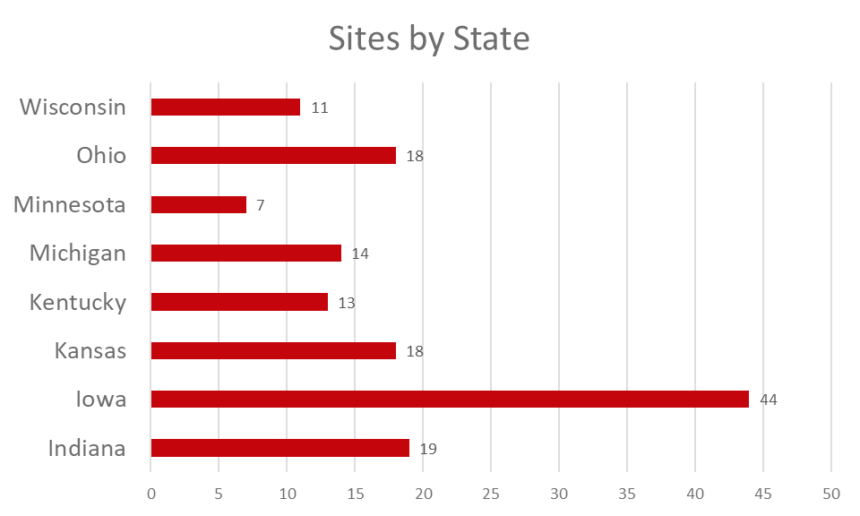
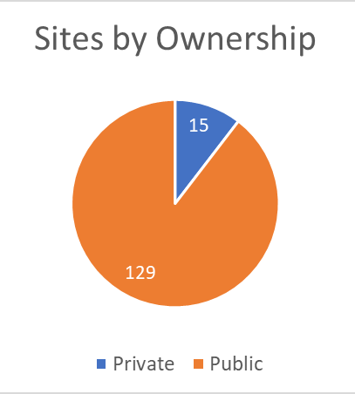
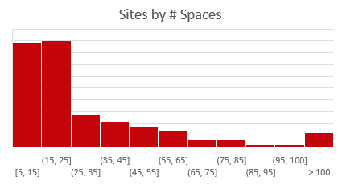
Overview of the Archive
Archive starting January 2019
144 total truck parking sites
5000+ parking spaces
160,000 records daily
148,651,162 as of Sep 5, 2023

Slide 6
Web portal – User access tiers
Tier | Purpose | Account Required? | Data Access | Admin Access | No. of Accounts
Tier 1 | Public Access | N | Performance reports only | N/A | N/A
Tier 2 | Authorized Users | Y | Performance report + Historical data (with limited data fields) | Optional | 4
Tier 3 | Full Access | Y | Performance reports + Historical data (full) | Optional | 19

Slide 7
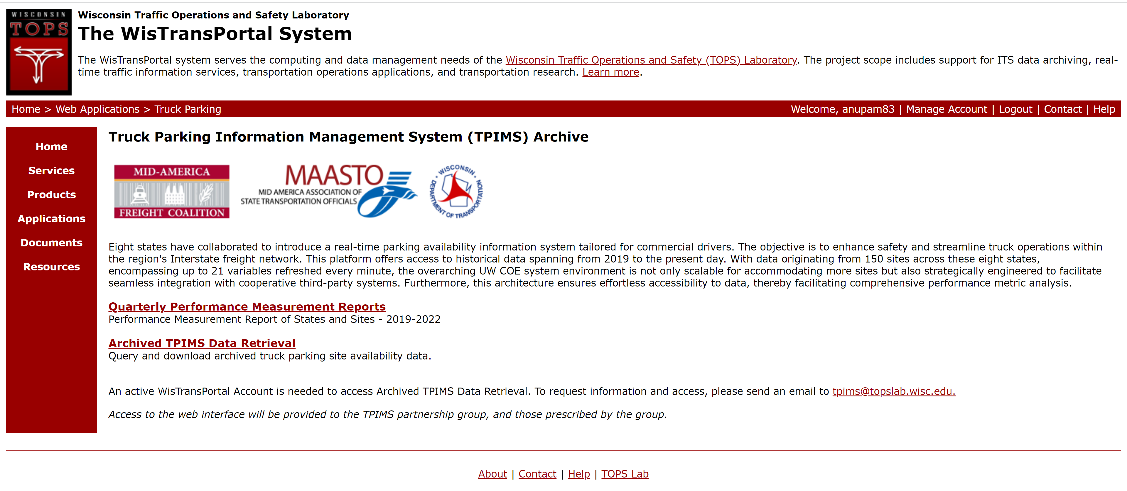
TPIMS Data Archival System Web Portal
https://transportal.cee.wisc.edu/tpims/

Slide 8
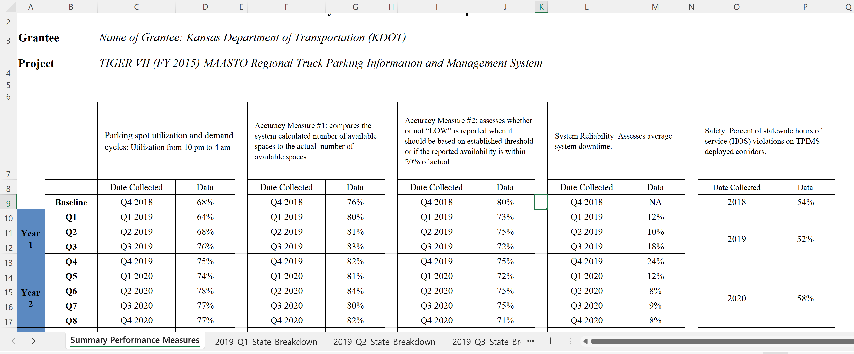
Performance Measure Summary – Grant Period

Slide 9
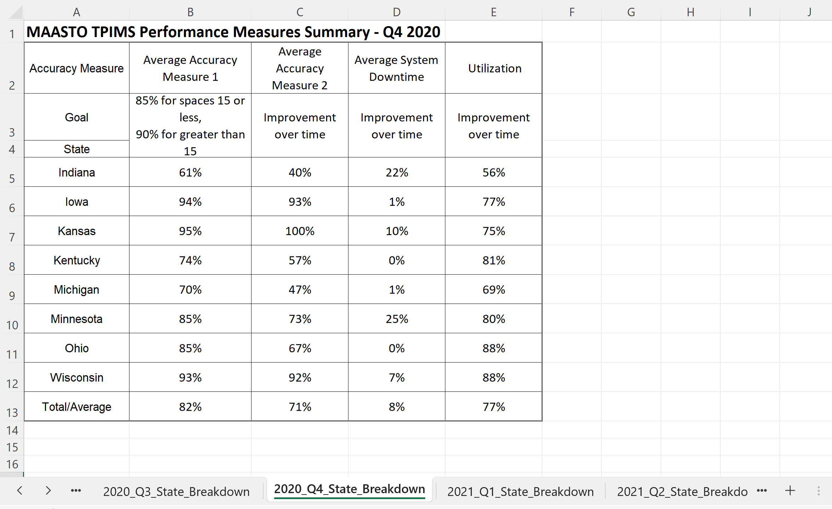
Performance Measure Summary - Quarter

Slide 10
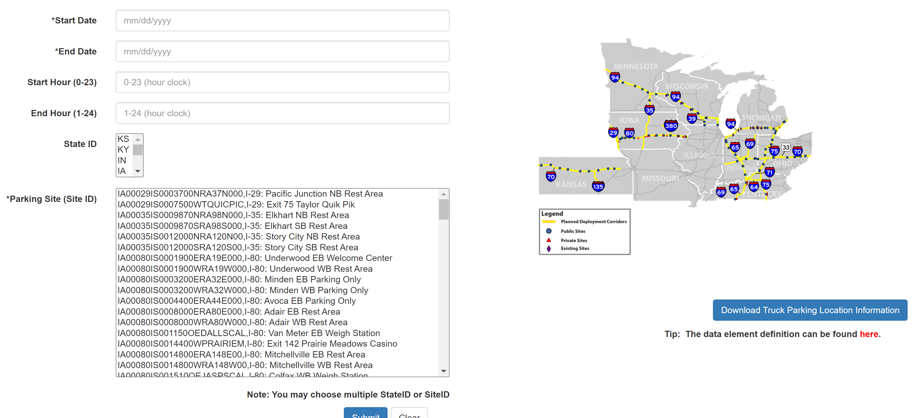
TPIMS Data Archival System Web Portal
https://transportal.cee.wisc.edu/tpims/

Slide 11
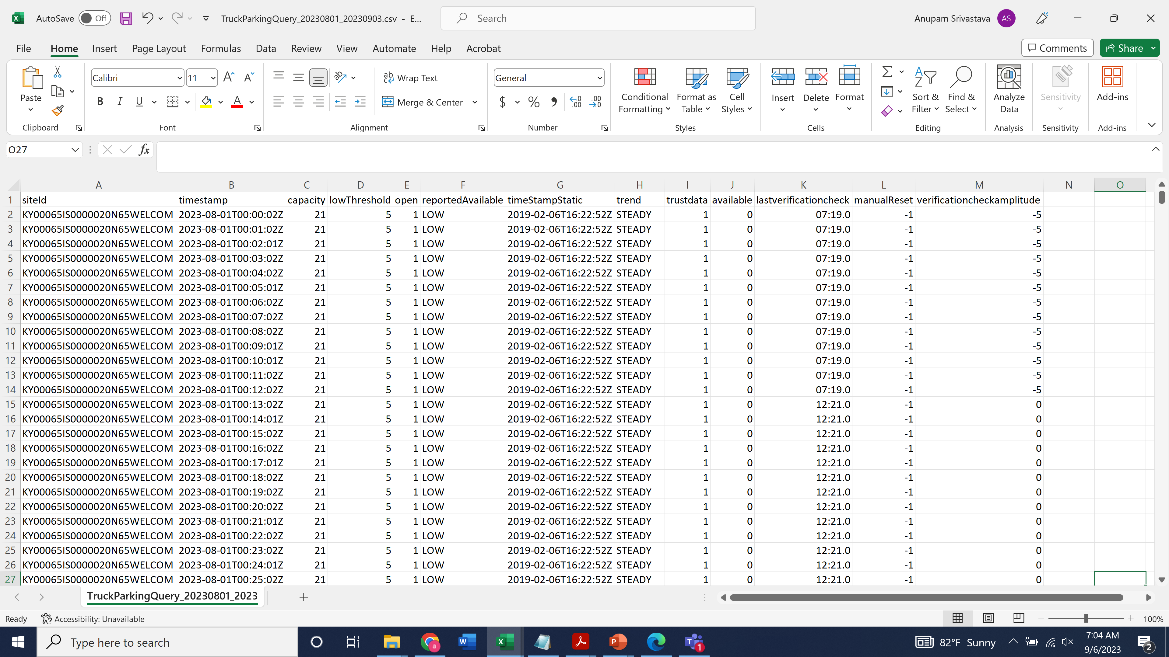
Sample Query Result – Archive Data

Slide 12
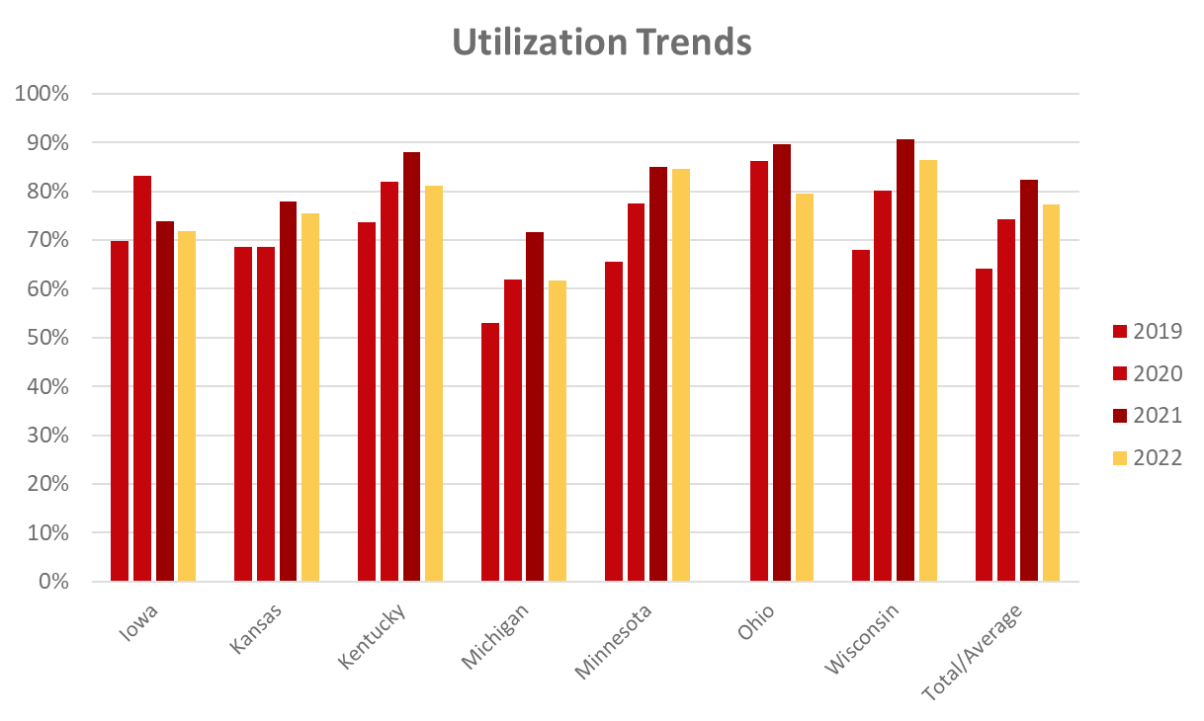
Applications – Utilization Trends

Slide 13
Applications – Occupancy by Time of Day

