Slide 1
Truck Parking in the MAASTO Region: More Spaces, More Technology, and Increased Collaboration!
MAFC Annual Meeting at the Ohio conference on Freight
Sept. 5- 7, 2023. Cincinnati, Ohio.

Slide 2
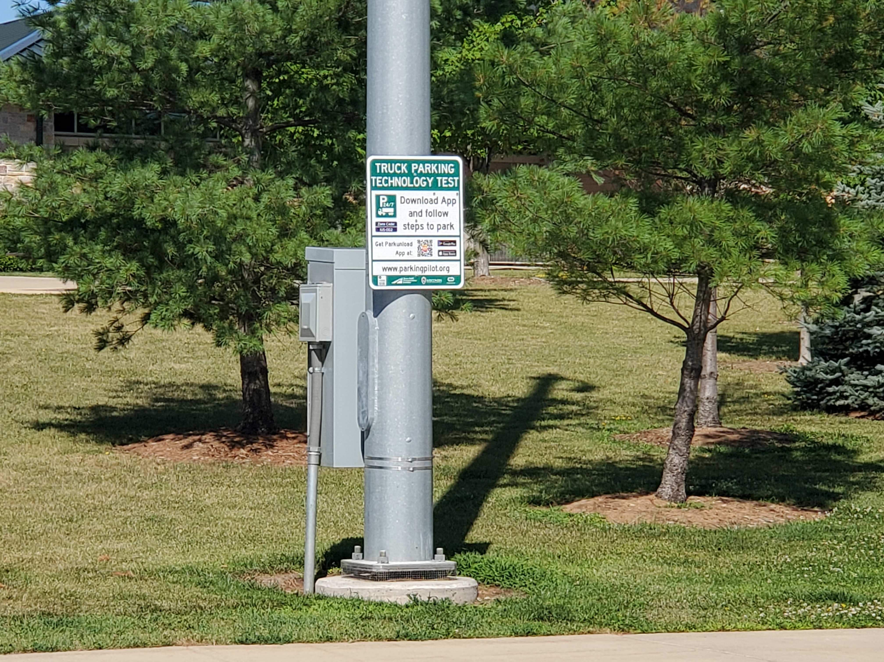
Overview
MAFC
Review of Constraints and Opportunities with Truck Parking
Truck Operations and
Regulations
Trends – Electrification, Decarbonization, Automaton.
Regional Truck Parking Research

Slide 3
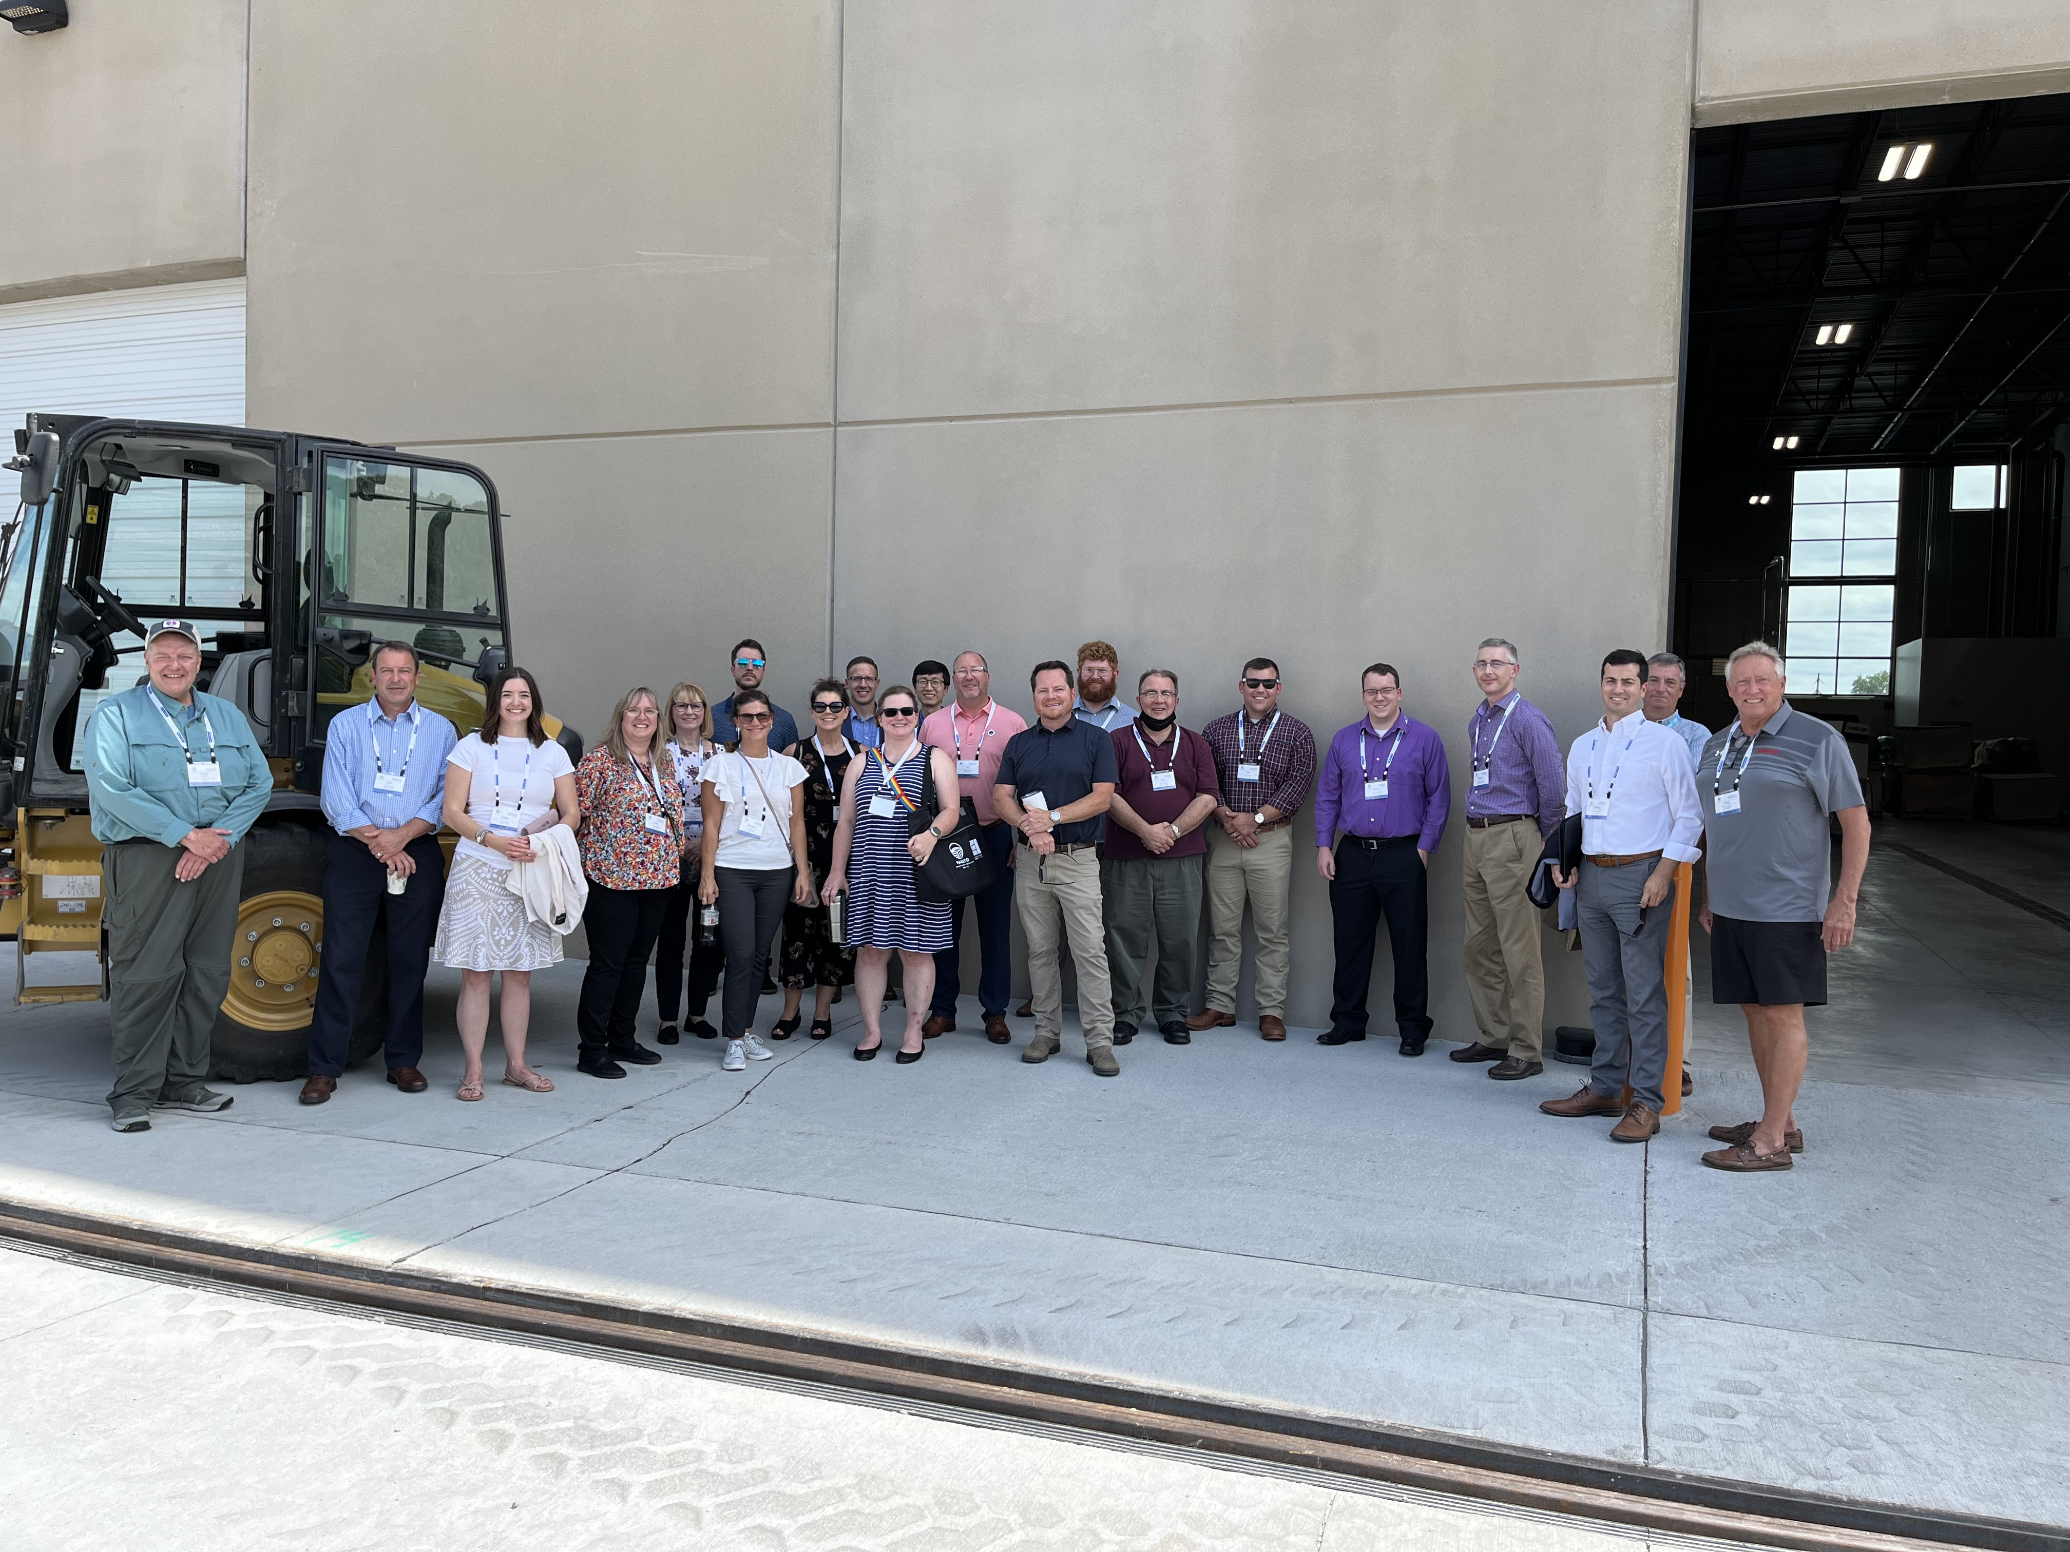
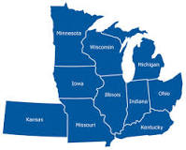
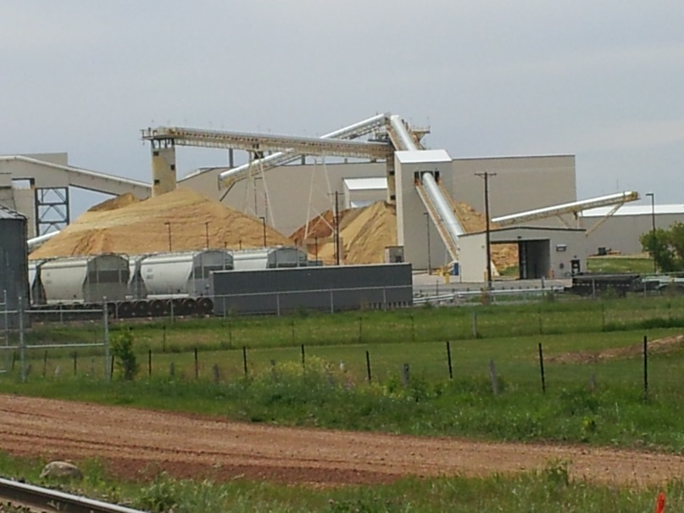
Mid America Freight Coalition – MAFC
https://midamericafreight.org/
2008, 10 states, networking, professional development, collaboration, and research!

Slide 4
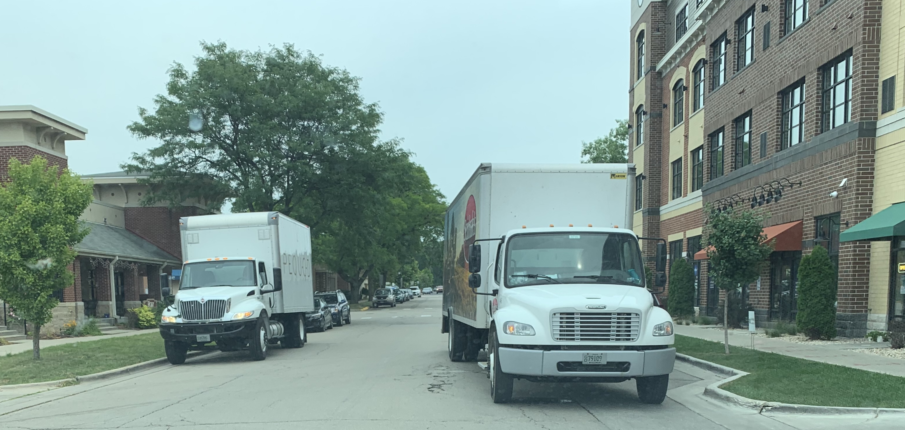
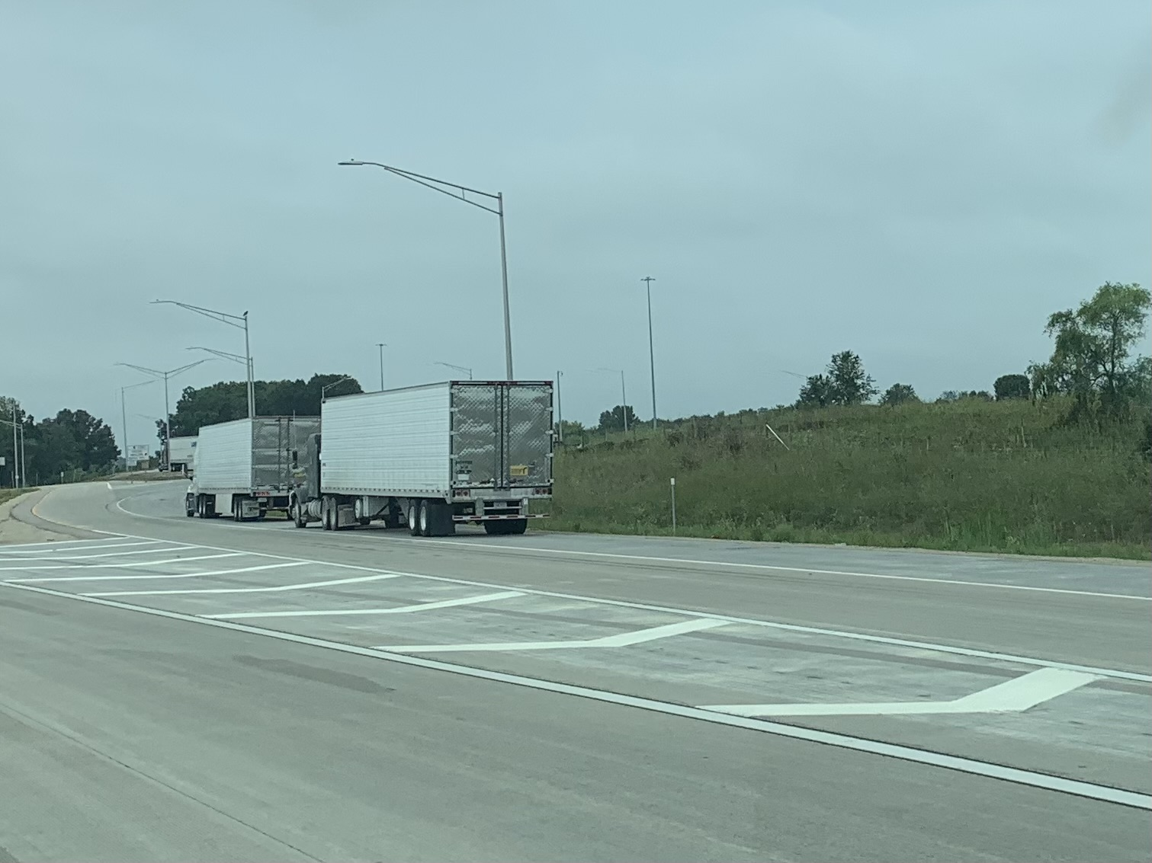
TRUCK PARKING - - Review of Constraints and Opportunities with Truck Parking
Safety! The Large Truck Crash Causation Study (LTCCS) reported that 13 percent of commercial motor vehicle (CMV) drivers were considered to have been fatigued at the time of their crash.¹⁵
# of spaces versus number of trucks with parking needs. According to the Owner-Operator Independent Drivers Association (OOIDA), there is only one parking spot available for every 11 trucks on the road
The U.S. Department of Transportation Federal Highway Administration lists the current shortage of more than 40,000 truck parking spaces as a national safety concern.

Slide 5
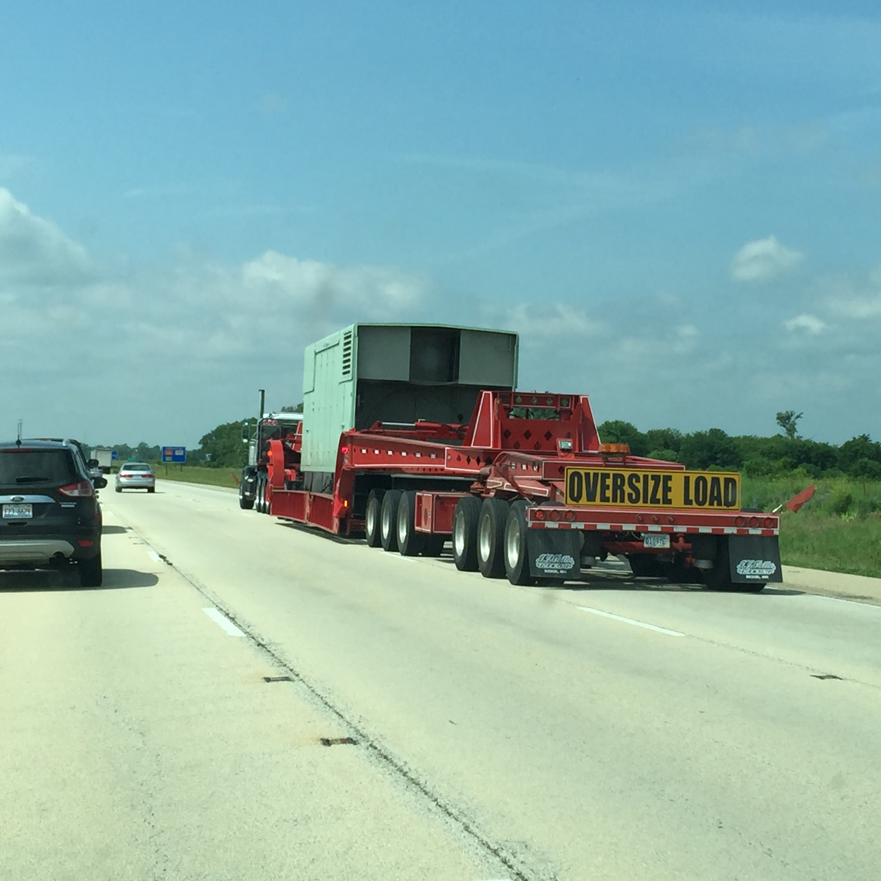
TRUCK PARKING - - Review of Constraints and Opportunities with Truck Parking, continued…
Location of parking and purpose of parking – short or long term, HOS related, queuing for loads or delivery?
Owner-Operator Independent Drivers Association wrote a letter to DOT earlier this year citing that 98% percent of drivers report problems finding safe parking, costing drivers more than 56 minutes of drive-time to find parking.
Services offered at parking area (OSOW, charging…?)
Randolph Sheppard Act, 20 U.S.C. 107
Economic Relevance
56 minutes of drive-time to find parking. That wasted time is estimated to cause a $5,500 loss in annual compensation – roughly a 12% pay cut.
Environmental relevance
Search time, idling, land use, proximity impacts to community features

Slide 6
PROPERTY-CARRYING DRIVERS
11-Hour Driving Limit May drive a maximum of 11 hours after 10 consecutive hours off duty.
14-Hour Limit May not drive beyond the 14th consecutive hour after coming on duty, following 10 consecutive hours off duty. Off-duty time does not extend the 14-hour period.
30-Minute Driving Break Drivers must take a 30-minute break when they have driven for a period of 8 cumulative hours without at least a 30-minute interruption. The break may be satisfied by any non-driving period of 30 consecutive minutes (i.e., on-duty not driving, off-duty, sleeper berth, or any combination of these taken consecutively).
60/70-Hour Limit May not drive after 60/70 hours on duty in 7/8 consecutive days. A driver may restart a 7/8 consecutive day period after taking 34 or more consecutive hours off duty.
Truck Operations to
Consider: Truck Driver HOS

Slide 7
Truck Operations to consider:
Randolph Sheppard Act, 20 U.S.C. 107
The law was subsequently amended in 1954 and again in 1974 to ultimately ensure individuals who are blind a priority in the operation of vending facilities, which included cafeterias, snack bars, and automatic vending machines, that are on federal property
Trends – NIMBY, environmental concerns, decarbonization, automation, driver shortage or turnover

Slide 8
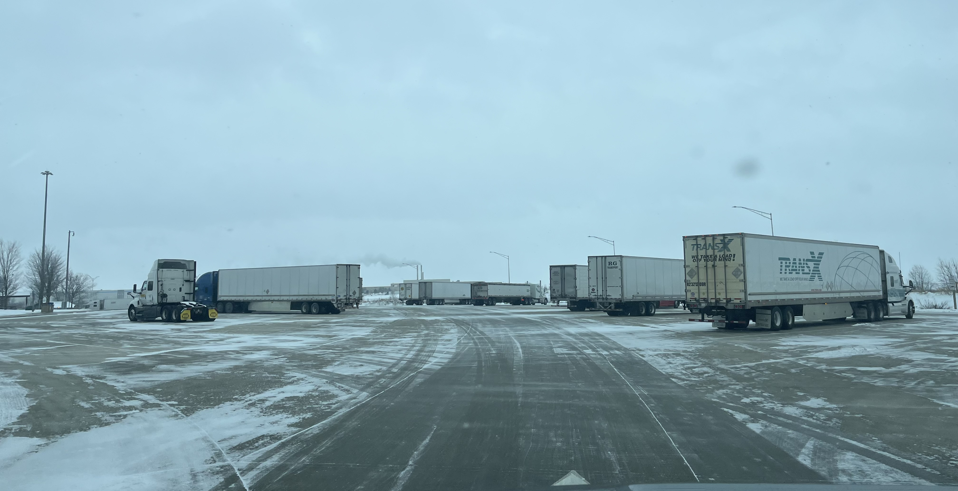
Truck Parking Research You should know about!
OSOW Regional Parking
GIS urban parking
Truck Parking Apps
TPIMS

Slide 9
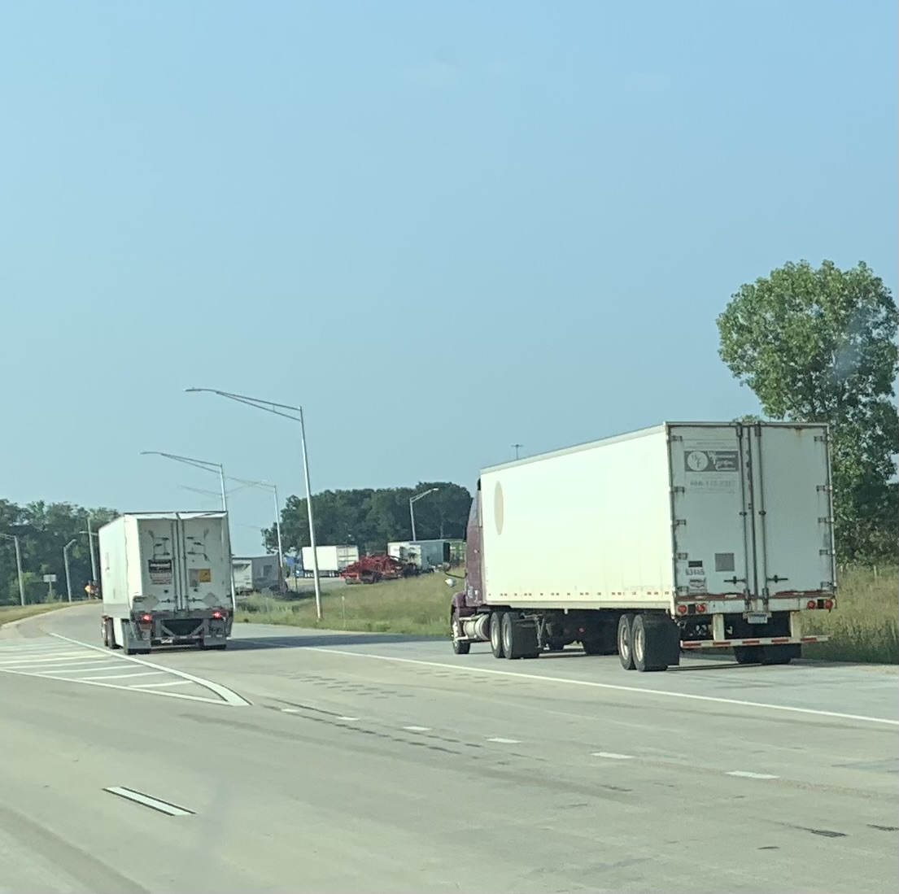
Recent MAFC Research on Truck Parking
https://midamericafreight.org/index.php/resources/
Truck Parking Management Systems: A Synthesis of Projects, Research, and Resources for MAASTO Decision Makers (2015)
MAFC 23: OSOW Support for MAASTO SCOHT and MCC (2019)
MAFC 21: Identification of Urban Truck Parking Locations in the MAASTO Region (2019)
TPIMS

Slide 10
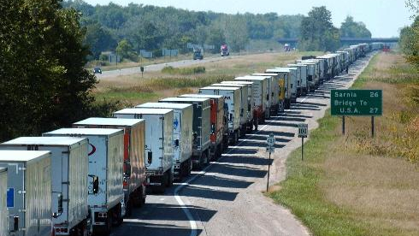
But what about the future - -safety!!
Work Force?
Automation? Consumerism? Environment ?
More Multimodal?

Slide 11
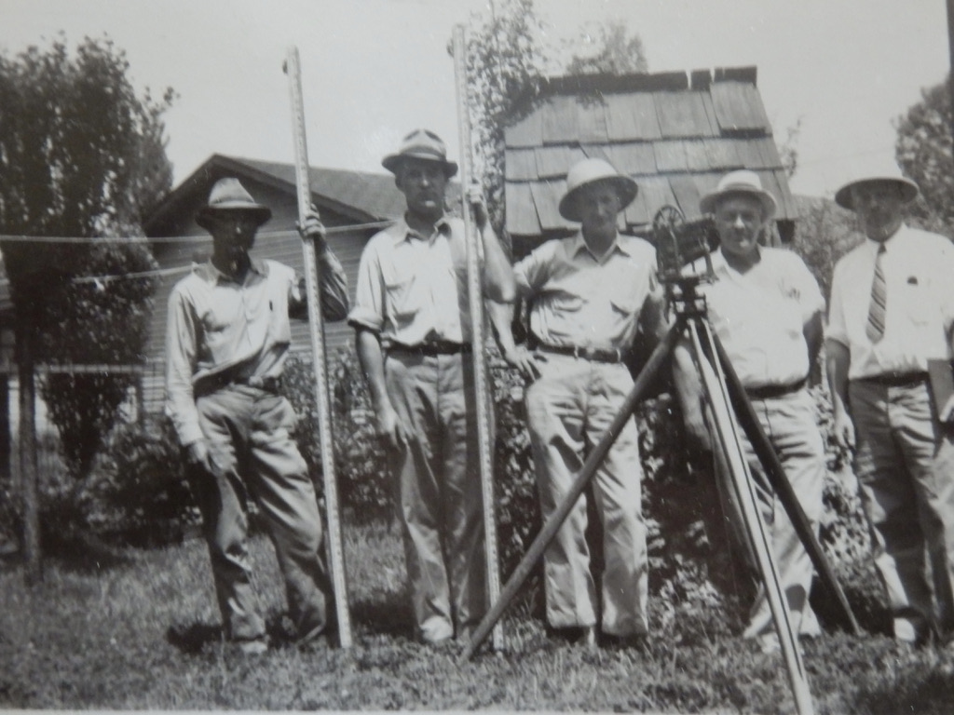
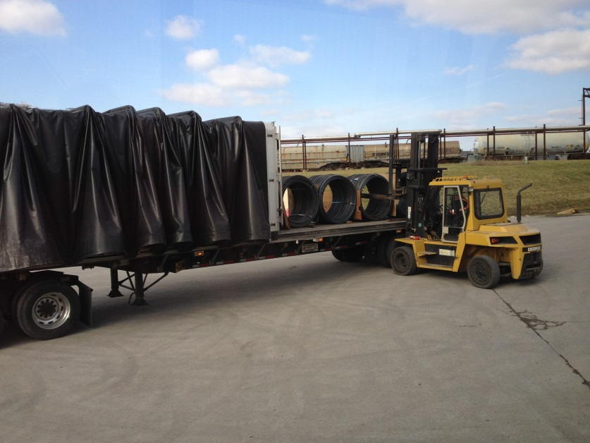
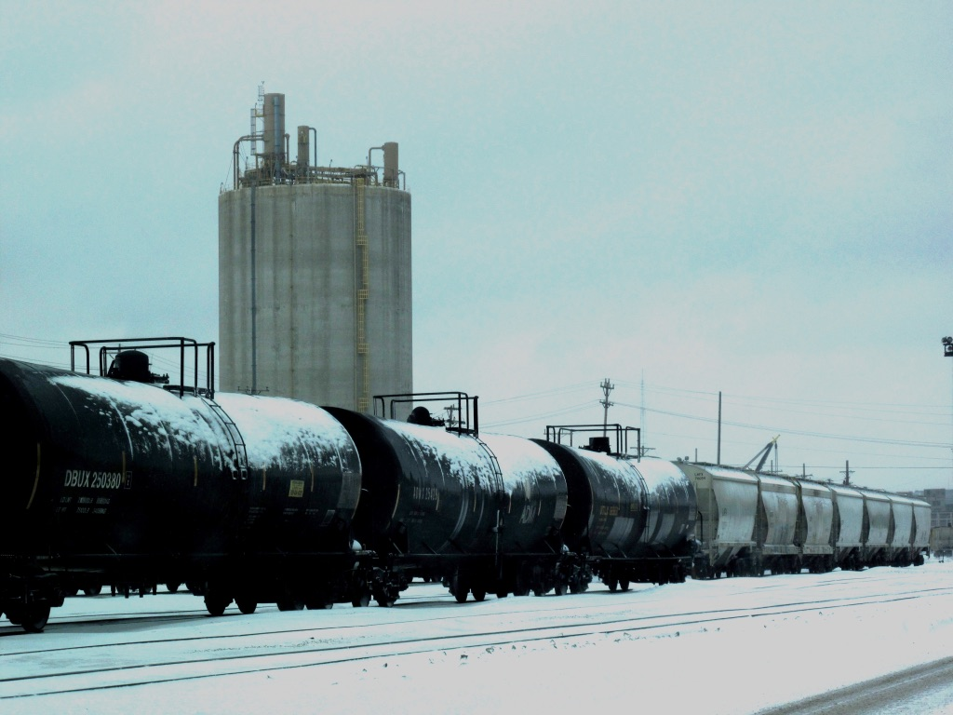
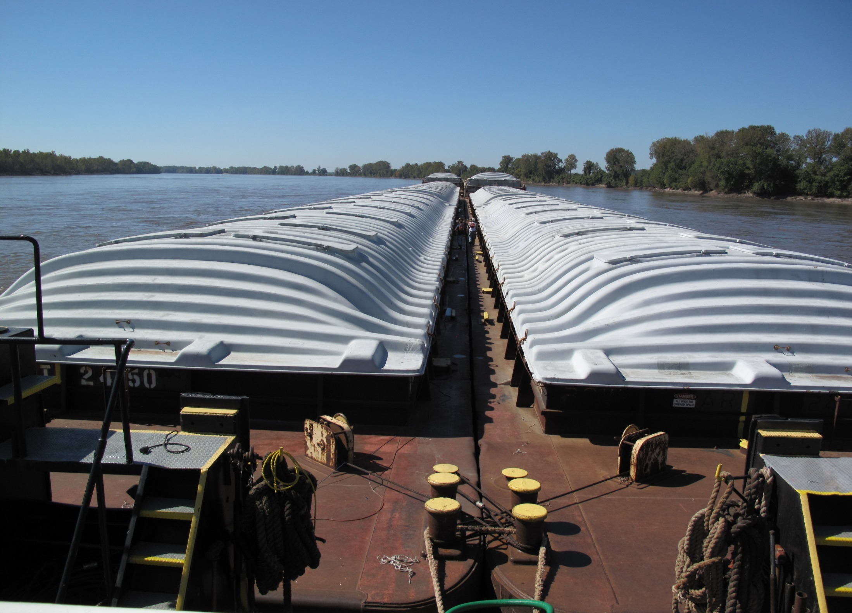
Ernie Perry, Ph.D.
MAFC
UW-Madison
ebperry@wisc.edu

