Slide 1
Parking Apps: The Good And The Not So Good
Jolanda Prozzi
Texas A&M Transportation Institute

Slide 2
Presentation Overview
Why is Truck Parking Important?
What Are We Doing?
How Does the Technology Work?
How Did the Pilot Work?
Data Collected
What Are the Good?
What Are the Not So Good?

Slide 3
Why Is Trucking Parking Important?
Truck parking - Number 1 concern for truck drivers
Many states have inadequate truck parking facilities (public and private)
98% of drivers reported problems finding safe parking
Insufficient safe parking
Creates safety hazard for all highway users
Prevents drivers from resting
Results in inefficiencies and increase costs

Slide 4
What Are We Doing?
Analyze use of truck parking capacity by time of day, day of week, and month
Truck Parking Information Management System
Telematics
Feasibility of Truck Parking Management Platform
ParkUnload App

Slide 5
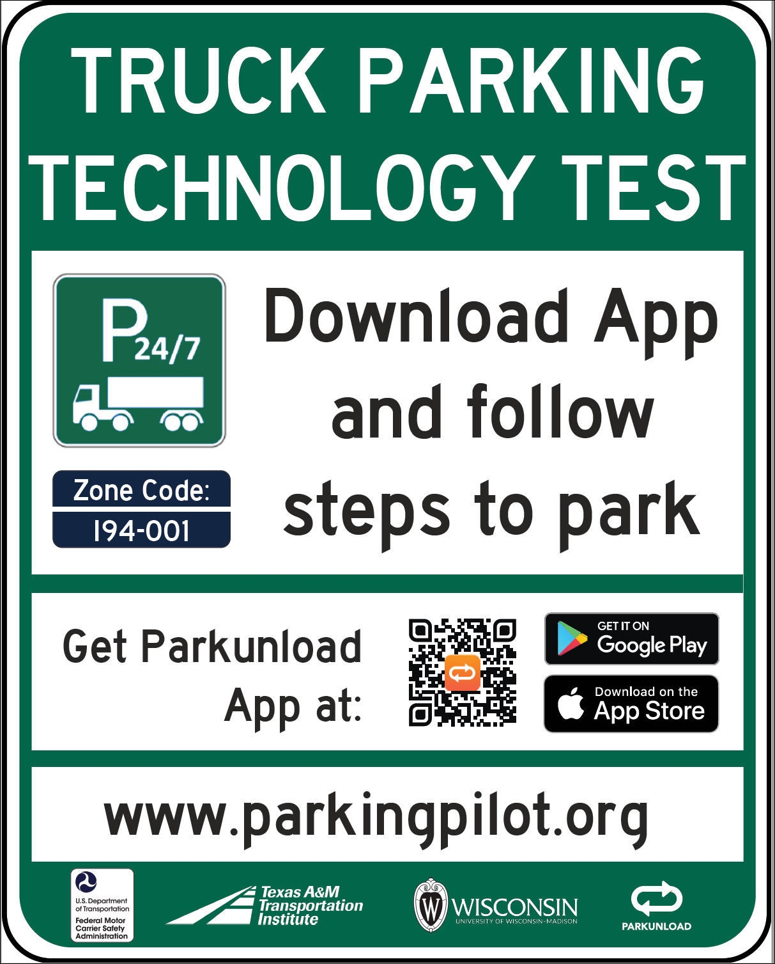
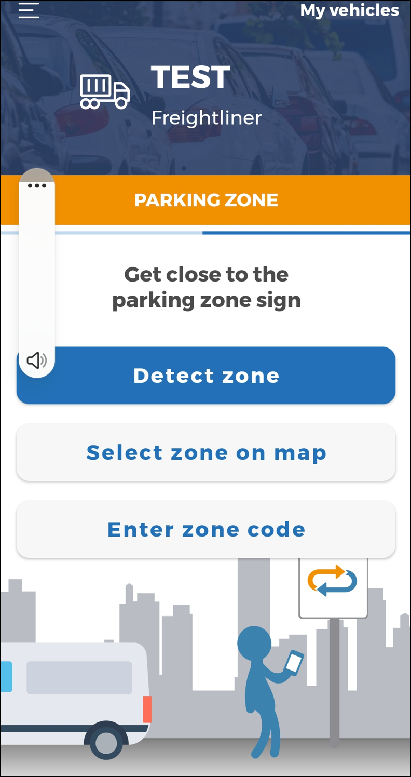
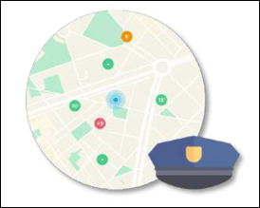
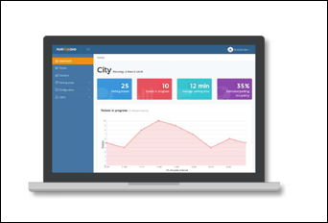
How does the ParkUnload Platform Work?
Bluetooth Enabled Sign
Mobile Phone App (Drivers)
Mobile Phone App (Enforcement Agencies)
Web-based Back Office

Slide 6
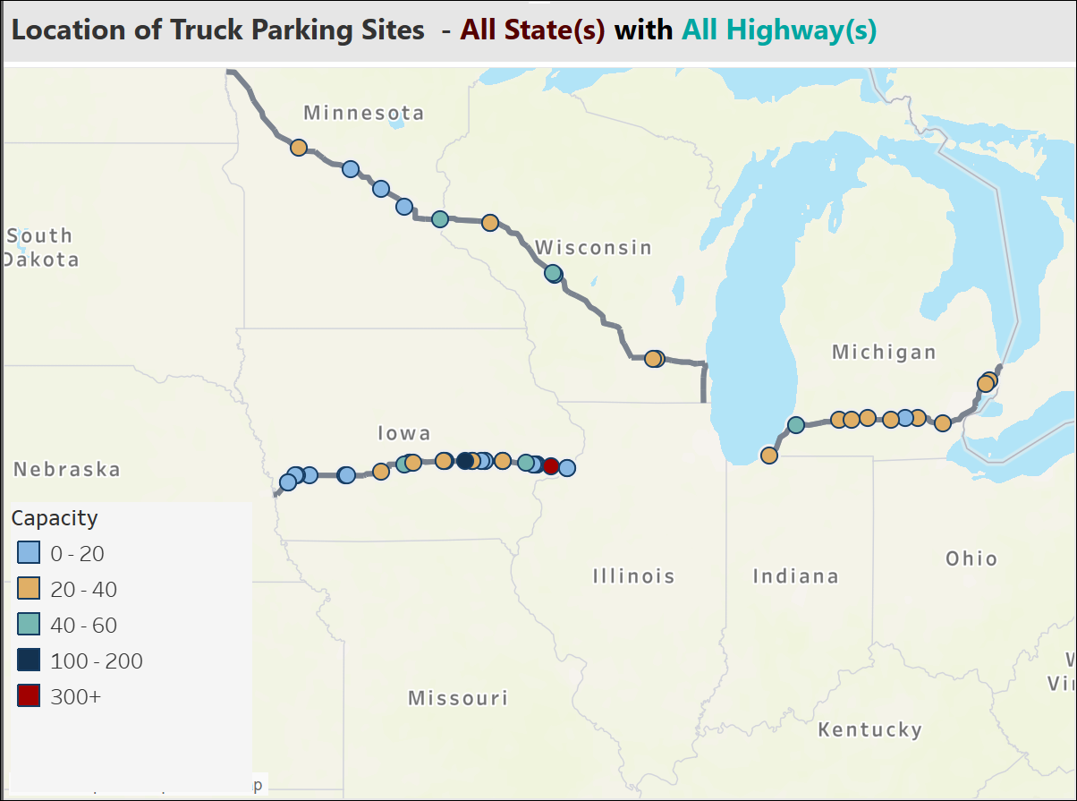
How Does the Pilot Work?
I-80 | I-39/90/94
East Bound Mitchellville Rest Area (EB) Wilton Rest Area (EB) Ladora Rest Area (EB) West Bound Mitchellville Rest Area (WB) Wilton Rest Area (WB) Ladora Rest Area (WB) | South Bound Janesville Rest Area 17 (SB) Portage Rest Area 12 (SB) North Bound Poynette Rest Area 11 (NB)

Slide 7
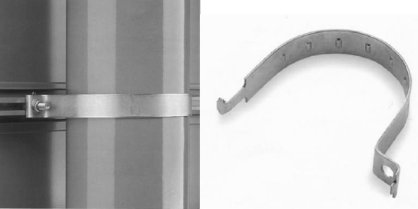

Slide 8
Pavement Markings

Slide 9
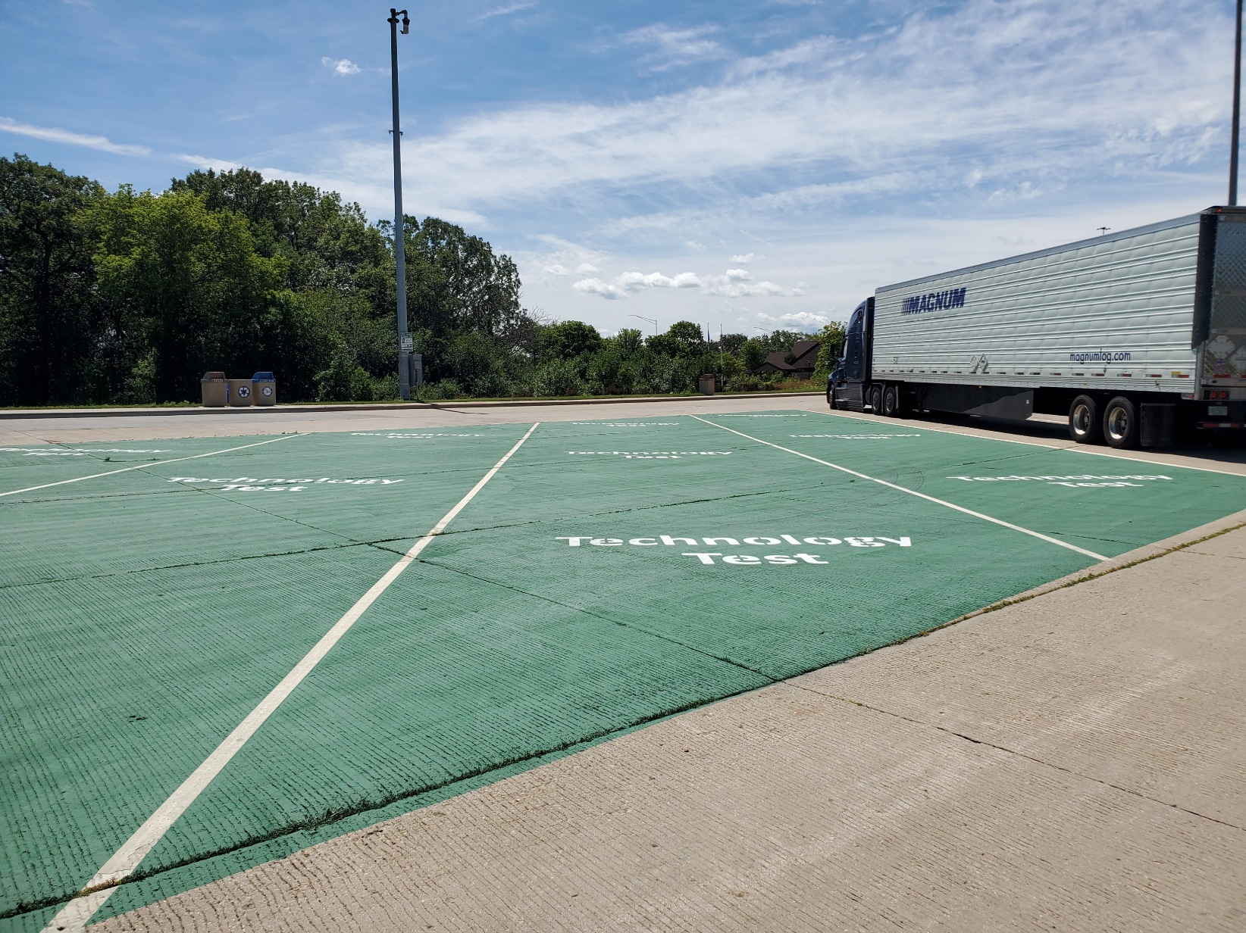
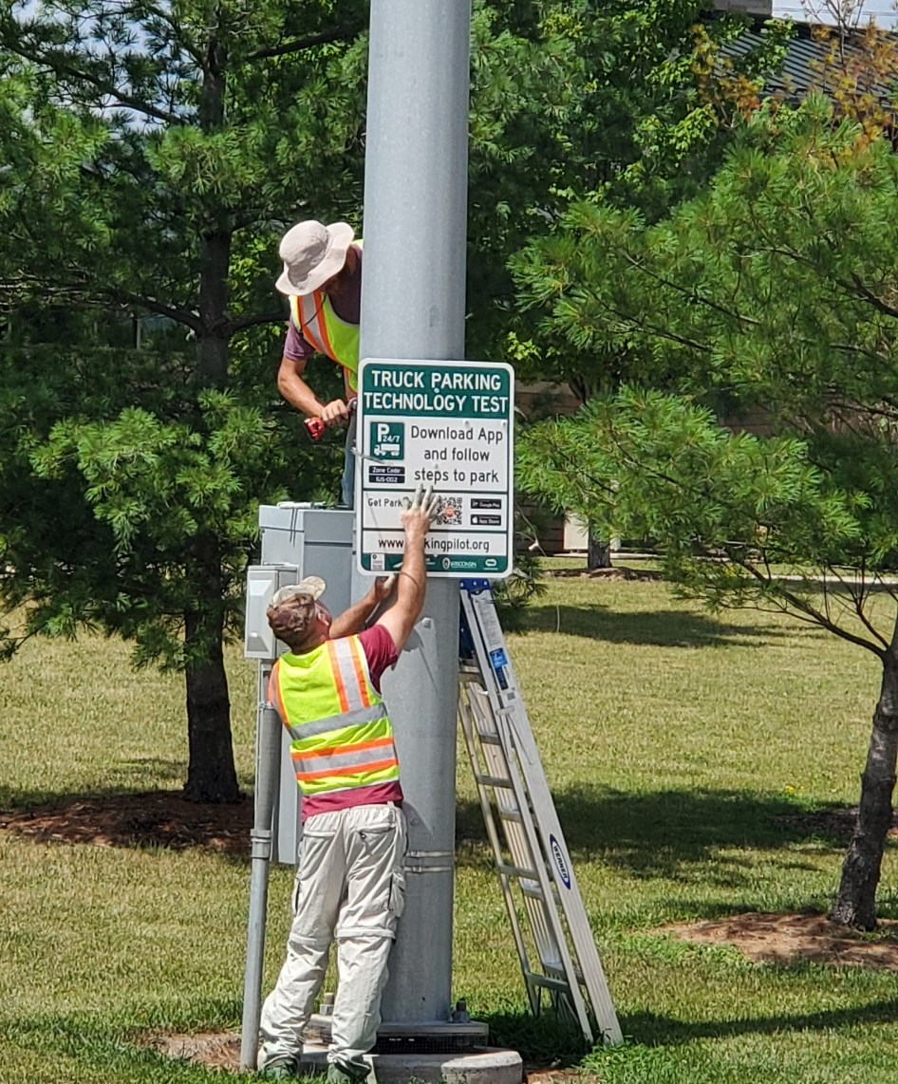
Install ParkUnload Platform – Week of July 17

Slide 10
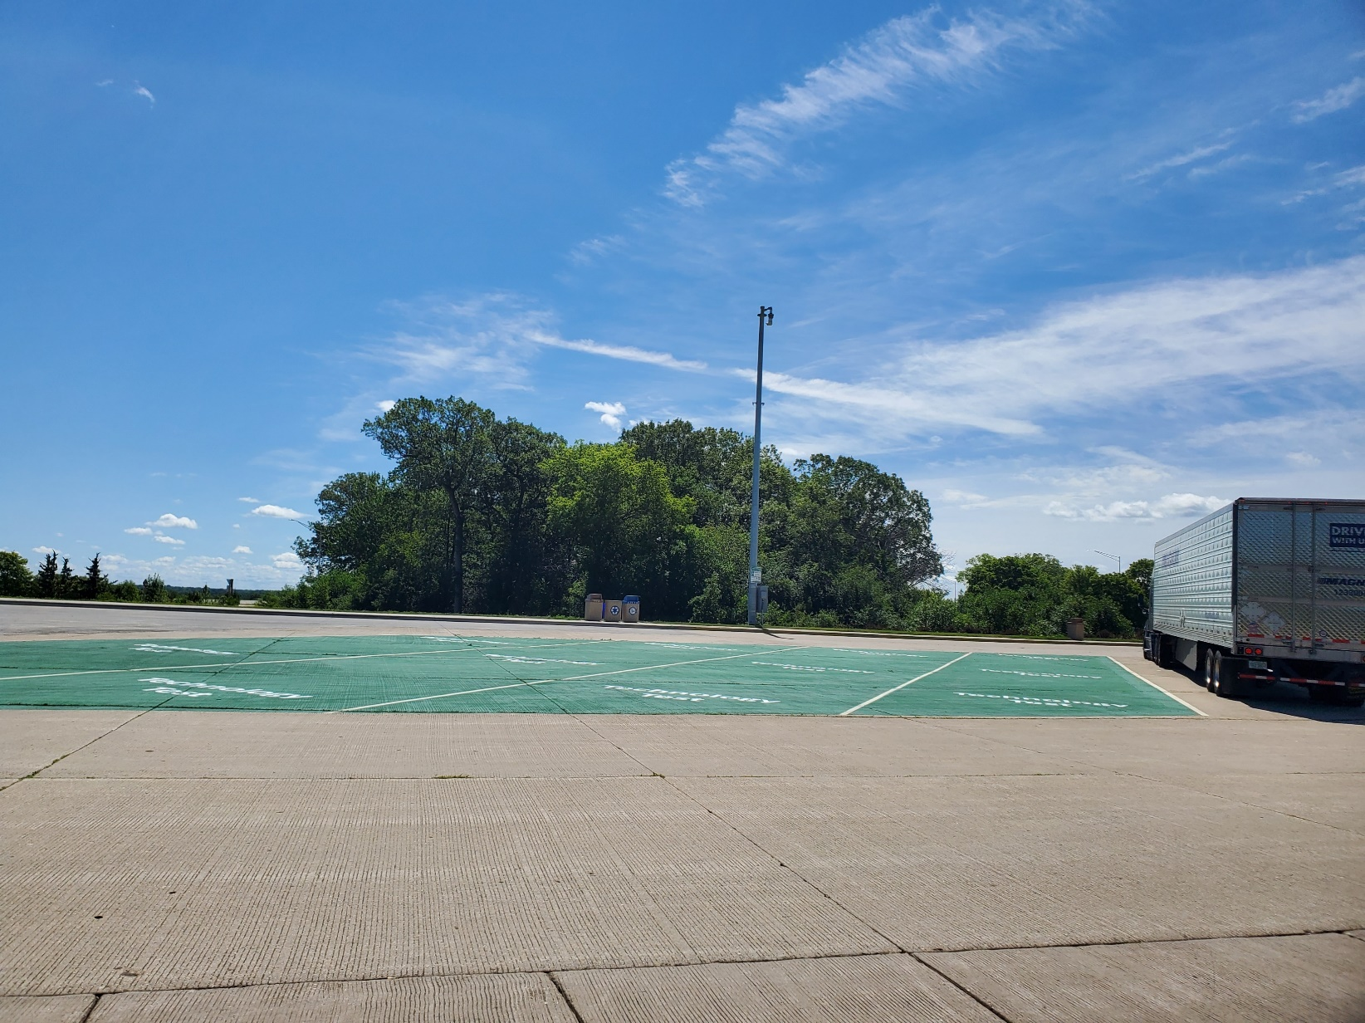
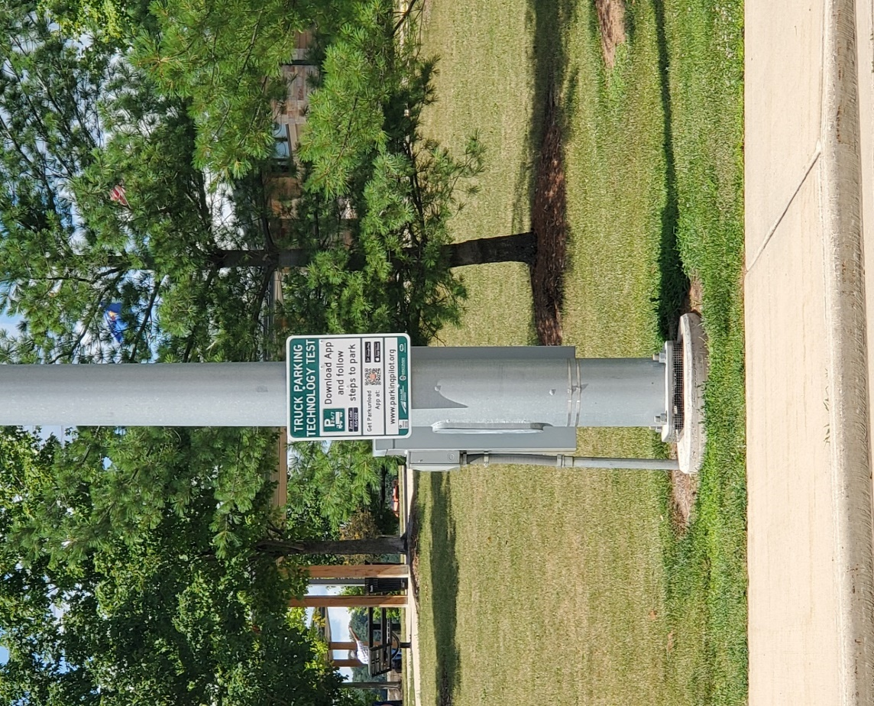
Install ParkUnload Platform – Week of July 17

Slide 11
Data Collected
Pilot Period
August 1, 2022 to July 31, 2023
496 ParkUnload App Downloads
Used ParkUnload App 694 times
Excluded 129 uses
Data for 395 truck drivers
564 valid uses

Slide 12
Data Collected

Slide 13
Data Collected
Social Media Outreach
Iowa Rest Area Monitors
Driver Surveys
Wisconsin Rest Area Posters
Notes:
Week of July 17, 2022 – Flyer handouts
July 21, 2022 – Press release
July 23, 2022 - Women In Trucking Show | SiriusXM
August 1, 2022 - Dave Nemo Show
August 8, 2022 Iowa DOT Blog post of Iowa DOT website
August 10, 2022 - Road Dog Trucking (Sirius XM)
October 4, 2022 – Social Media Outreach
Mid-January 2023 – Iowa Rest Area Monitors
Week of February 20, 2023 – Wiscon Rest Area Posters
March 15, April 19, and May 19, 2023 – Qualtrics Survey of App users.

Slide 14
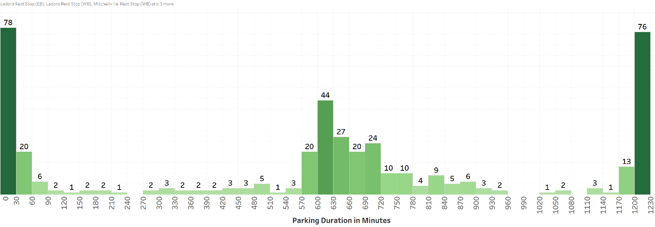
Time Parked Per Session (I-80)
338 truck drivers used the App 418 times
18.7% 30 minutes or less
32.3% spent 9.5 to 13.5 hours
18.2% 20 or more hours

Slide 15
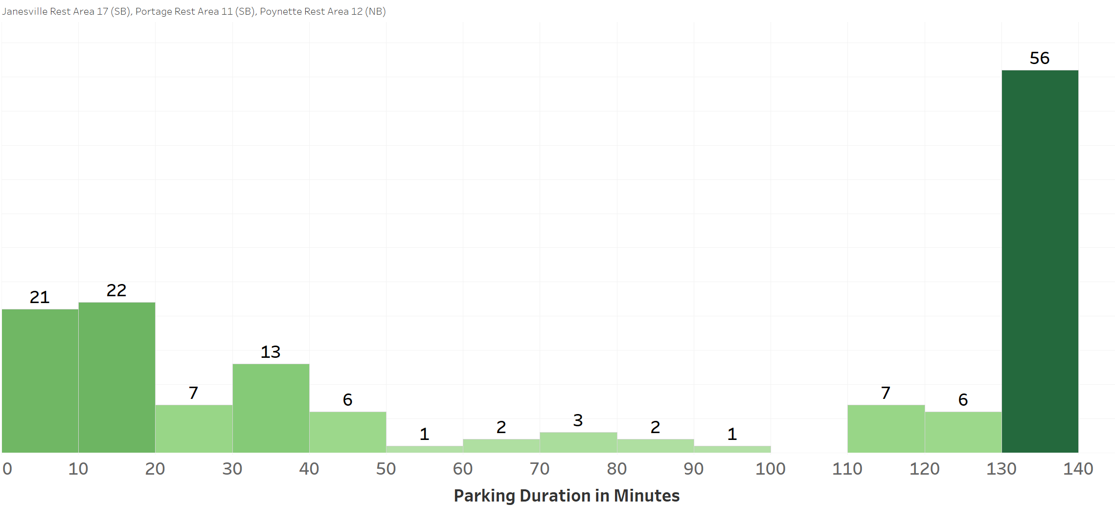
Time Parked Per Session (I-39/I-90/I-94 Corridor)
106 truck drivers used the App 147 times
38% parked 130 to 140 minutes
34% park 30 minutes or less

Slide 16
Number of Parking Sessions Every 30 minutes of a Day (I-80 Corridor)
No Parking Time Specified
Time Truck Driver Checks In

Slide 17
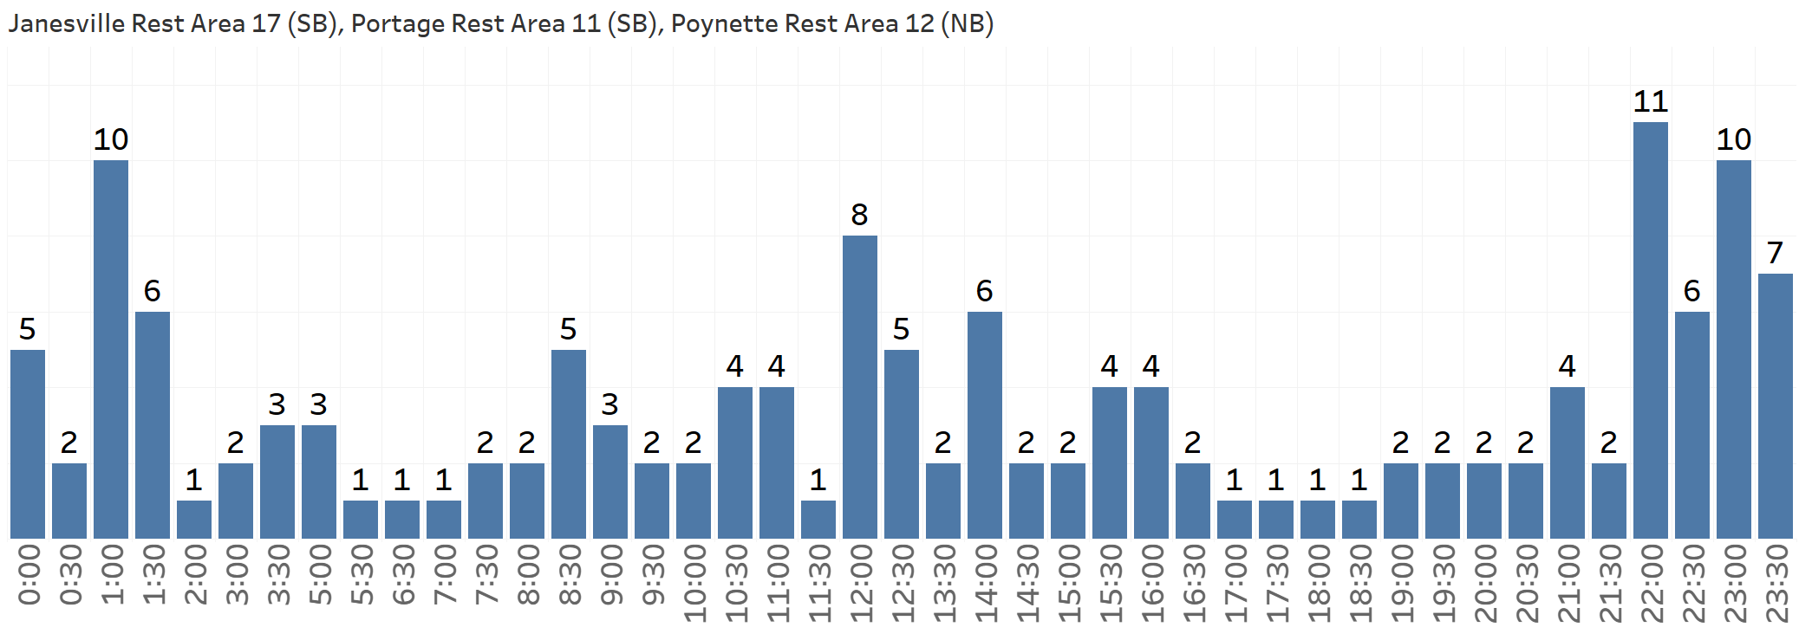
Number of Parking Sessions Every 30 minutes of a Day (I-30/I-90/I-94 Corridor)
Two Hour Parking Limit Specified
No Enforcement
Time Truck Driver Checks In

Slide 18
What did the drivers say?
Social Media Sentiment
Stop research and invest in free truck parking
Spaces have to physically be there. They are not. Quit wasting time with technology & get out there & make more spots. There are NONE in Va on 81 at night. And cops will wake you up on the ramp if youre desperately needing a nap on the ramp …”
Anti-App Sentiment
”Another App, just what this country needs!!”
Suspicion
”… they studying how to charge you via app.”
“Just want you to log in so they can cross your logs to it... no thanks”

Slide 19
How difficult is it to find available long-term parking (more than 7 hours) at the rest area you most frequently use?
What did the drivers say?
Wilton EB
Janesville Rest Area 17 (2)
Portage Rest Area 11
Poynette Rest Area 12
Poynette Rest Area 12
Mitchellville WB (2)
Victor EB
Wilton WB (2)
Janesville Rest Area 17
Portage Rest Area 11 (2)
Wilton EB (2)
Mitchellville WB
Poynette Rest Area 12
Victor EB

Slide 20
How difficult is it to find available parking for a short duration (less than 2 hours) between 8:00 pm and 6:00 am?
What did the drivers say?

Slide 21
Please rate how easy it is to use the Parkunload APP to check in (and out) of the spaces included in the Truck Parking Pilot project (i.e., the green-painted parking spots)?
What did the drivers say?

Slide 22
In your opinion, is Parking Technology (such as, the ParkUnload App) useful in finding where and when parking is available at rest areas?
What did the drivers say?

Slide 23
What did the drivers say?
ParkUnload App Users
I would like to see the program expanded to all parking spaces. I believe it would be more useful then.
You would need a way to enforce the parking; otherwise, anyone can take the parking spot.
Parking is a big problem, whether it’s for a 30 minute break or 10 hours.
I wasn’t in the trial area often and usually forgot to use the ap

Slide 24
What Are the Good?
Low-cost technology
Eliminates need for Dynamic Message Signs
Communicates number of parking spaces available and location of parking spaces in real time for all instrumented facilities
More comprehensive data on truck parking capacity usage
Private truck facilities
Drivers can reserve truck parking space
Notes:
Travel Centers of America Prefferred Parking Program

Slide 25
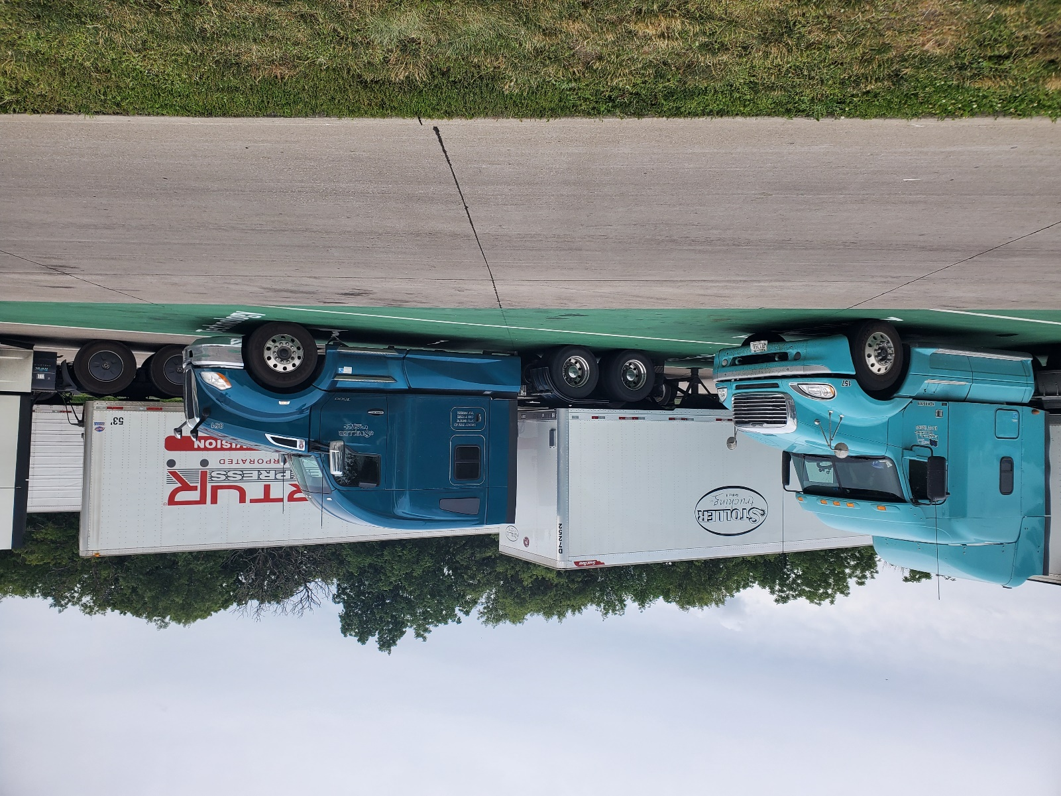
What Are the Not So Good?
Relying on driver to download and use app
Average age of driver is >50
Too many apps
Driver compliance
Checking in and checking out of parking space
Getting information to drivers
RV usage of parking spaces

Slide 26
Where Could Technology be Useful?
Truck Stops
Personnel
Interest in diversifying services (designate short term parking, parking reservations, preferred parking programs)
Smaller rest areas (10 to 15 spaces)
Niche markets (OS/OW loads)

Slide 27
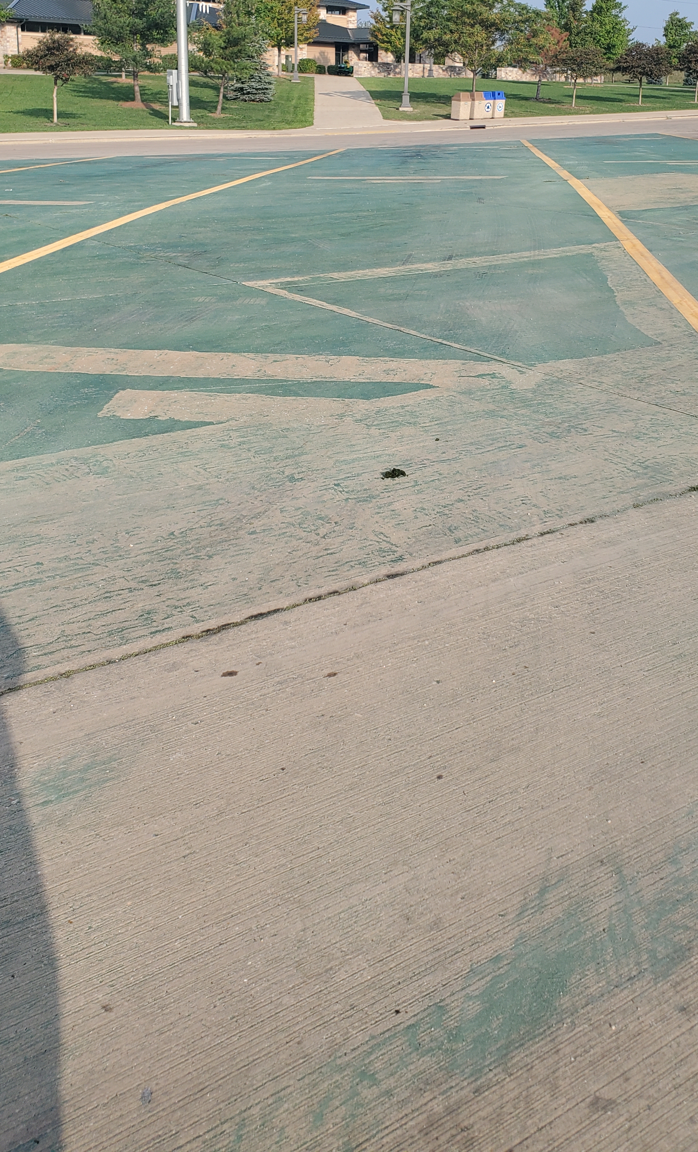
Questions
Jolanda Prozzi
j-prozzi@ttimail.tamu.edu
Ernest Perry ebperry@wisc.edu
www.parkingpilot.org

