Slide 1
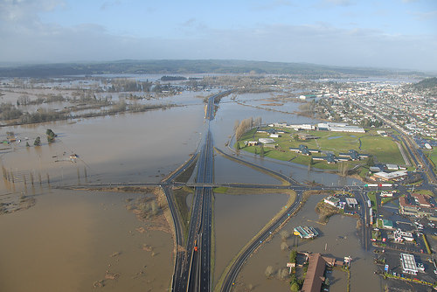
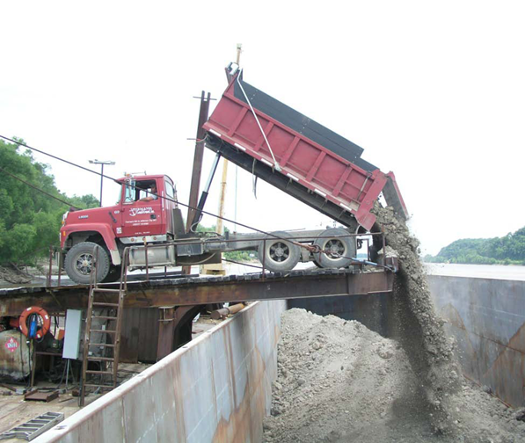
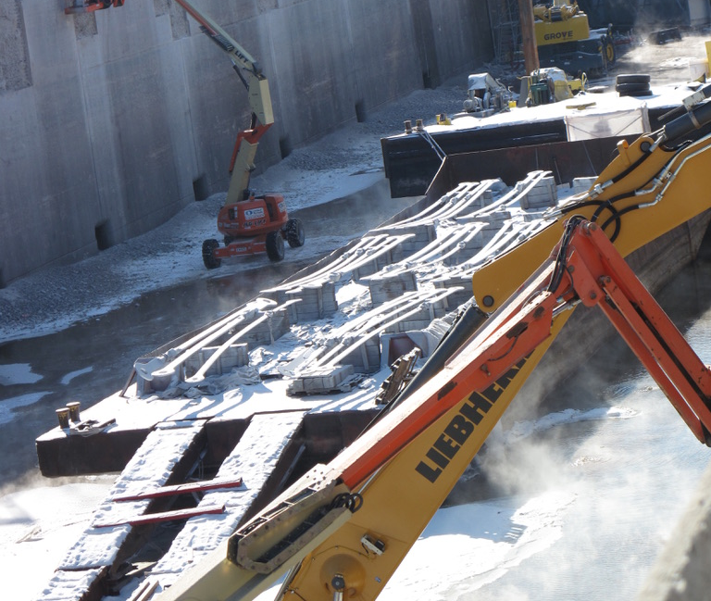
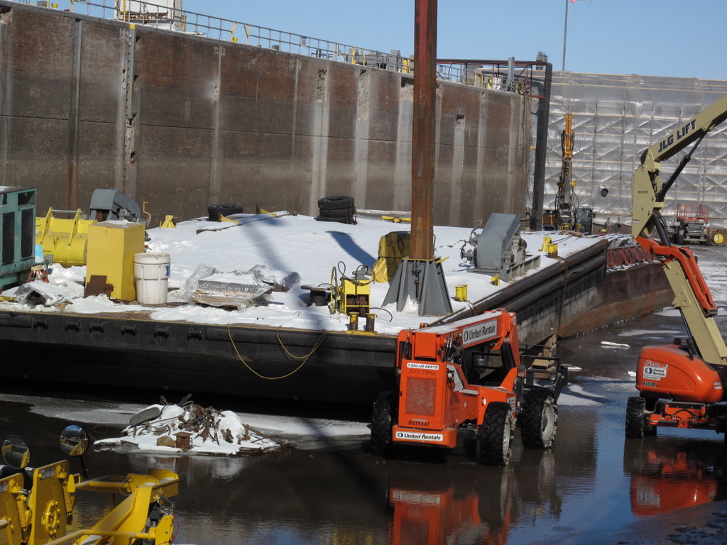
Time, Environment and Resiliency
Ernie Perry, Ph.D. Mid America Freight Coalition
MAASTO Summer Meeting. July 25-27/2022

Slide 3
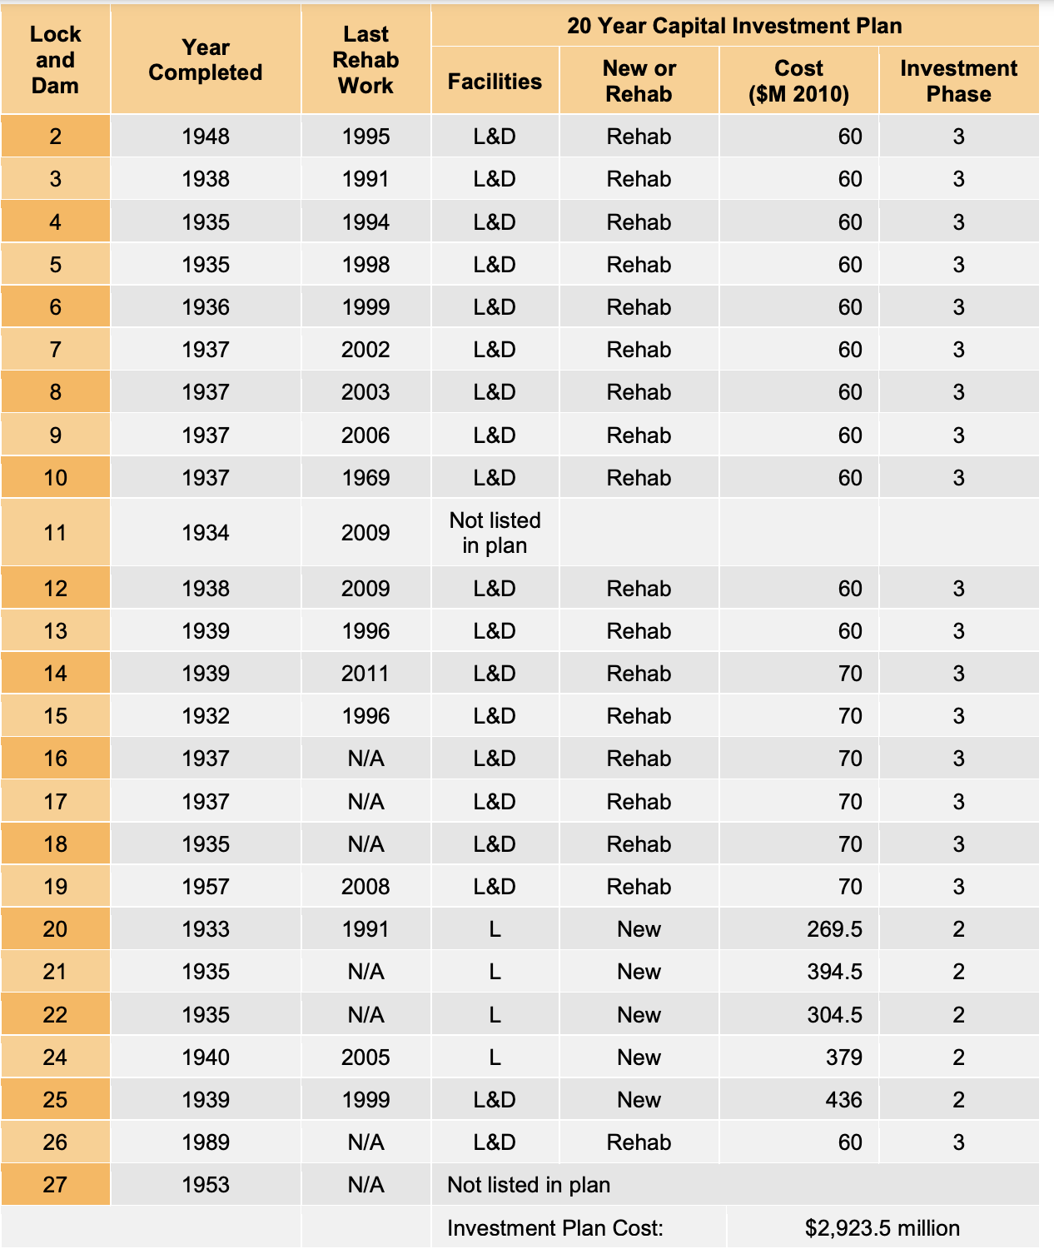
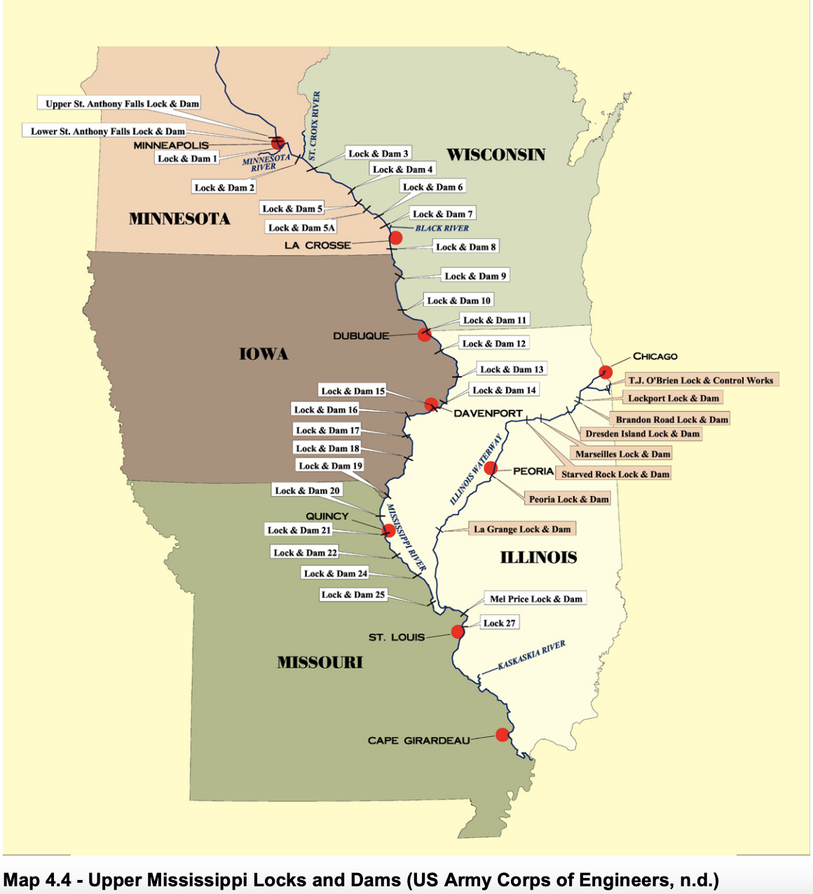
Lock and Dam 15 – 1932!
Lock and Dam 26 - 1989!
Upper Mississippi River Lock and Dam Buildout

Slide 4
Previous Studies demonstrate similar patterns.
Modal shift has focused on rail.
This is not a new issue!
Results in increased cost to producers, general travelers, and agencies.
Also increases in crash rates and marginal costs.

Slide 5
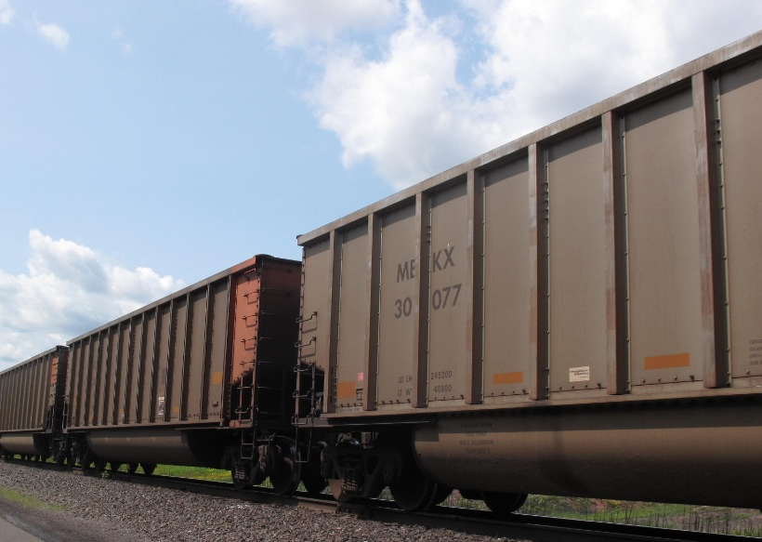
What we Did -
Provide a “what if” comparison of what an equivalent volume of river traffic would look like on the highways, this project examines two scenarios: 1) all agricultural loads shifted to trucks, and 2) 75% of agricultural loads shifted to trucks and 25% shifted to rail.

Slide 6
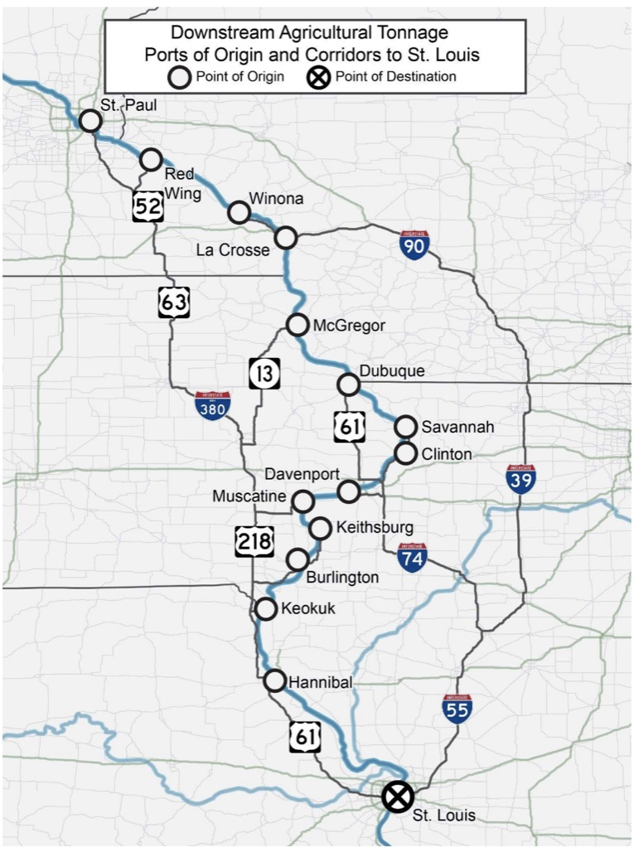
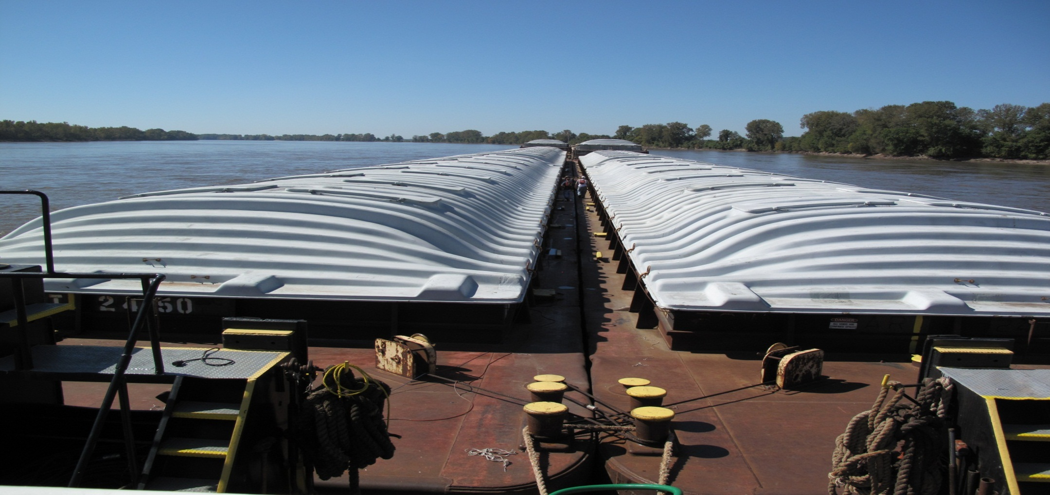
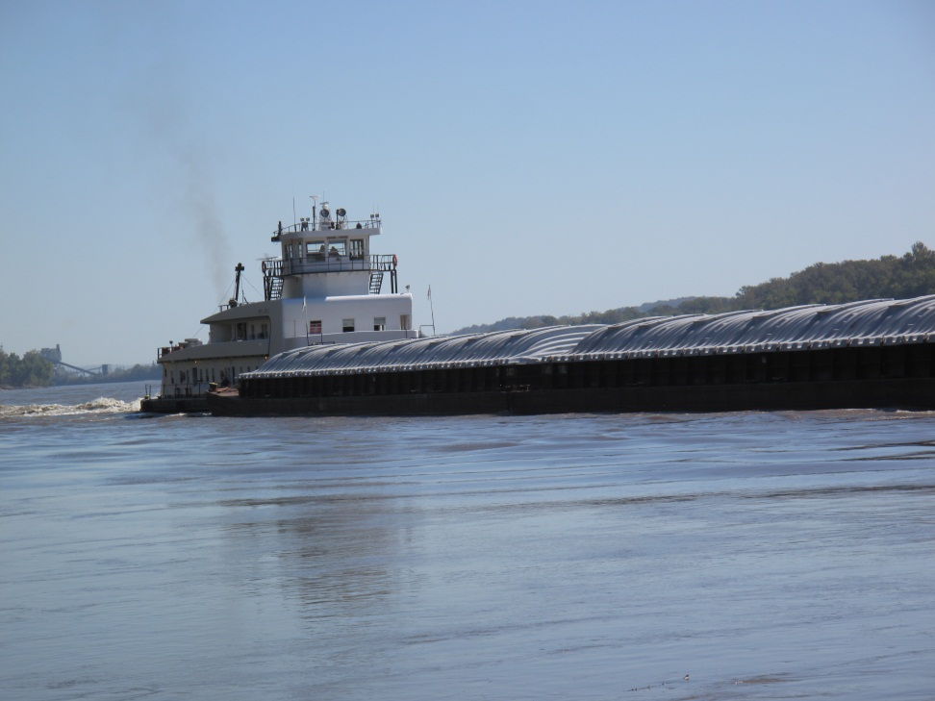
The Upper Mississippi System

Slide 7
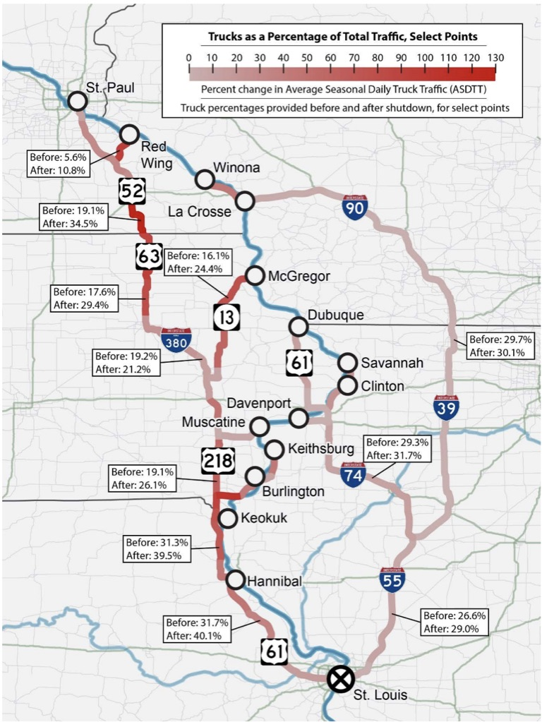
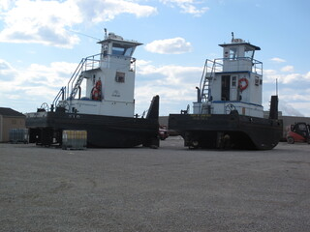
What we found – increased user costs, increased maintenance cost, increased environmental and social costs.

Slide 8
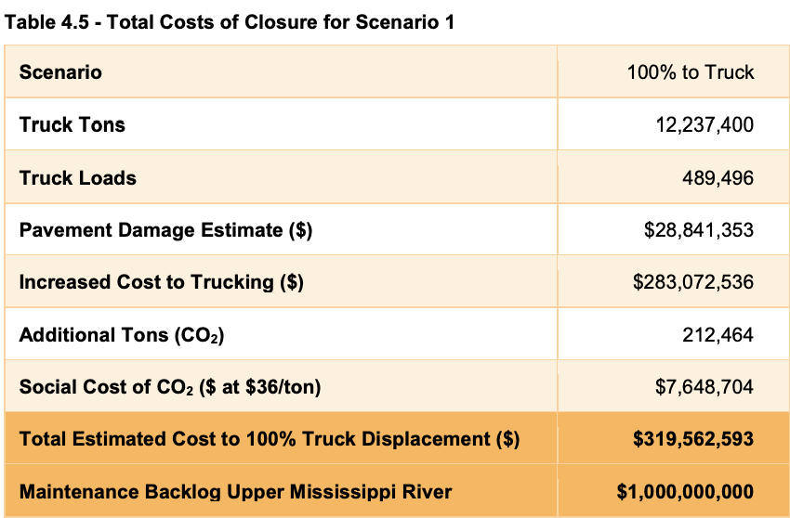
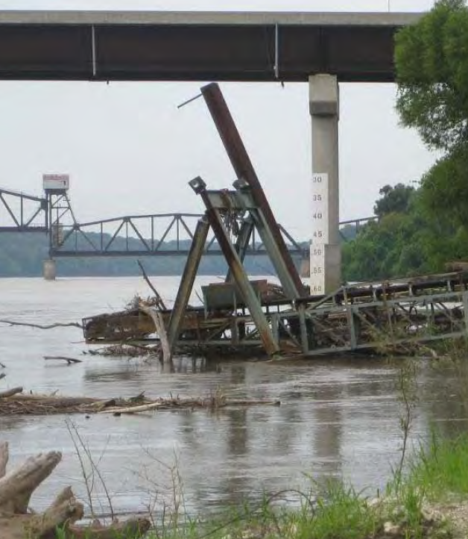

Slide 9
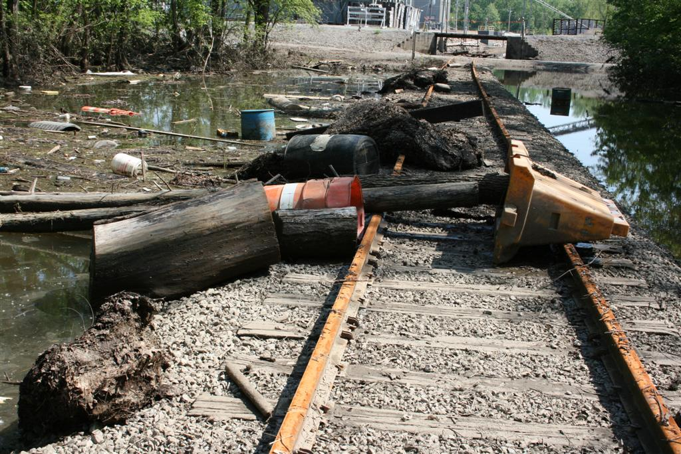
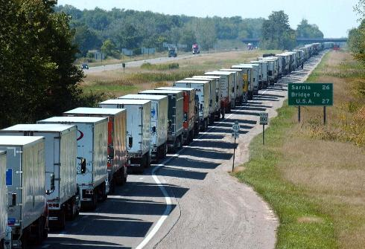
If 100% or 75% of the Upper Mississippi’s downbound agricultural commodities shifted to truck and traveled to St. Louis. Between 367 and 489 thousand truckloads would be generated, and, if enough trucks and drivers were available, shipping costs for trucking would range between $21 and $28 million. Rural highways on the western side of the river would experience the greatest increases in truck traffic, and greatest increases in trucks as a share of total traffic.

Slide 10
The Army Corps of Engineers estimates that maintaining the control structures of the Upper Mississippi and Illinois rivers costs $115 million, annually, and yields $1 billion in transportation cost savings (US Army Corps of Engineers, 2016). Looking toward the future, inland waterway tonnages are expected to increase by 23% from 2010 to 2050 (HDR, 2013). Additional investment in the Upper Mississippi’s infrastructure will be needed to maintain the system and accommodate future growth. Currently, 54% of the infrastructure on the Upper Mississippi River is more than 50 years old and 36% are more than 70 years old. Fix as fail is not a viable long-term solution given the importance of agricultural exports to the five Upper Mississippi states.

Slide 11
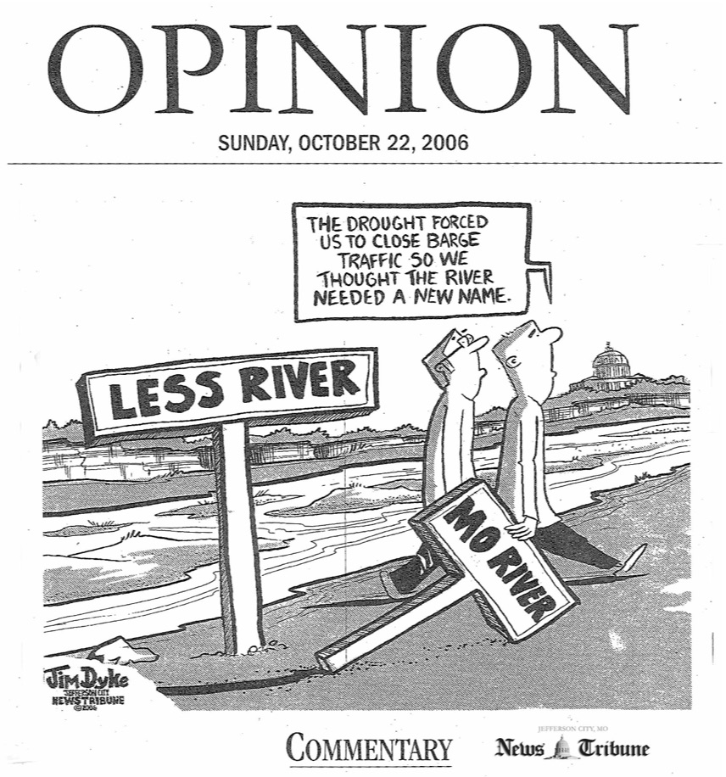
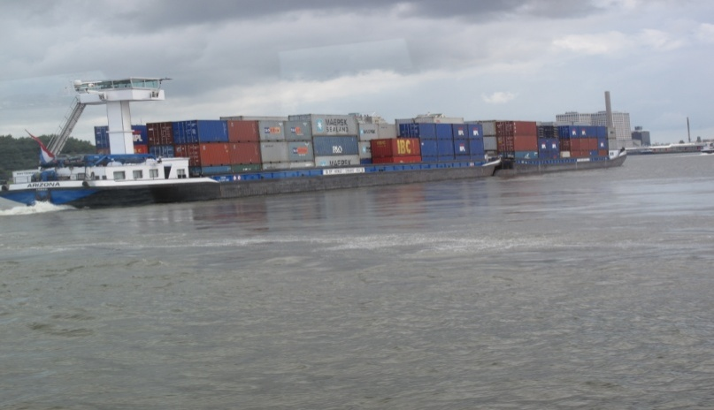
Reasons for resiliency issues on our waterways:
Investment approach has been "fix as fail”,
Historic and continued lack of investment,
Perceived and real reliability and service issues,
Extreme flood and drought conditions,
Economic prioritization for investments favors larger systems,
Historic USACE construction contracting practices,
Shipper emphasis on rail and truck.

Slide 12
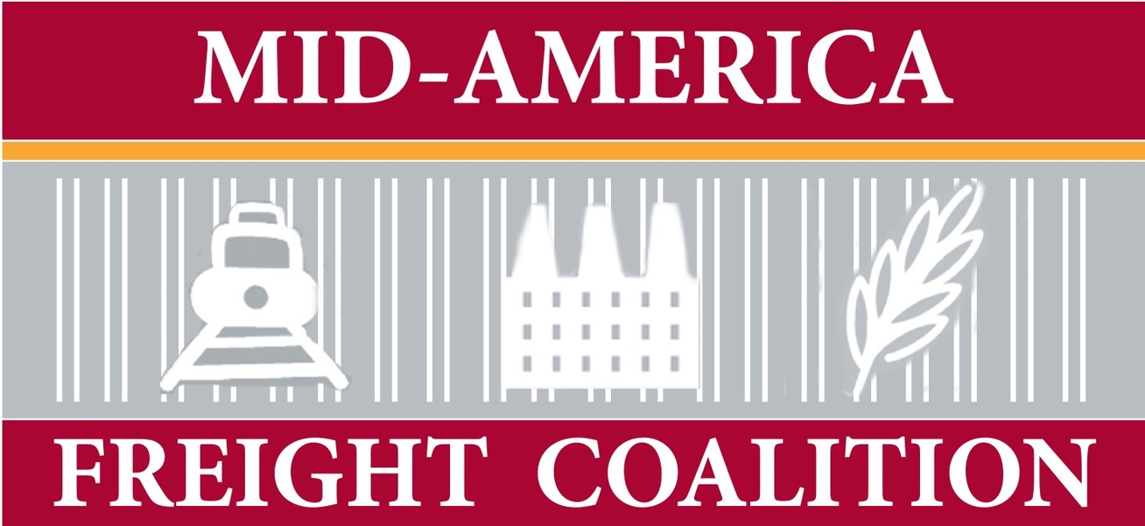
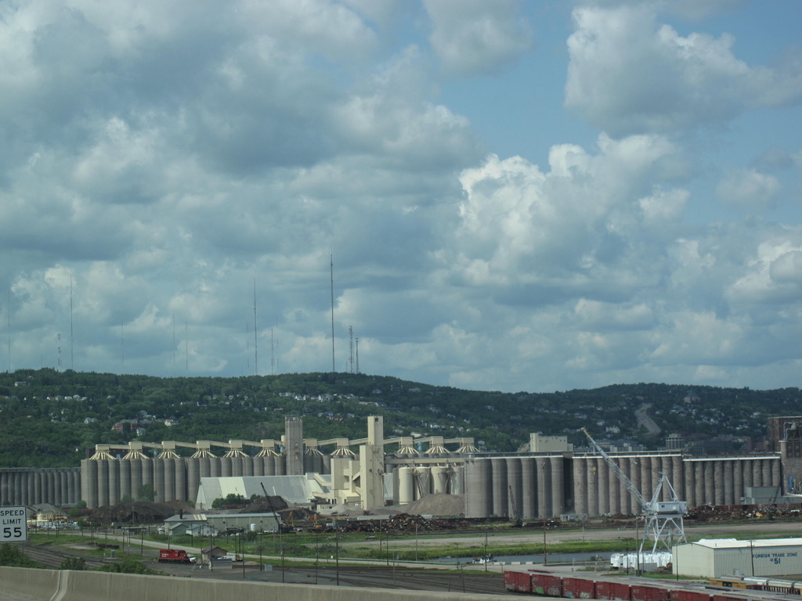
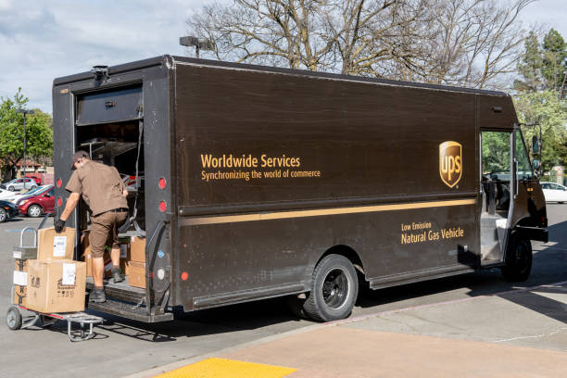
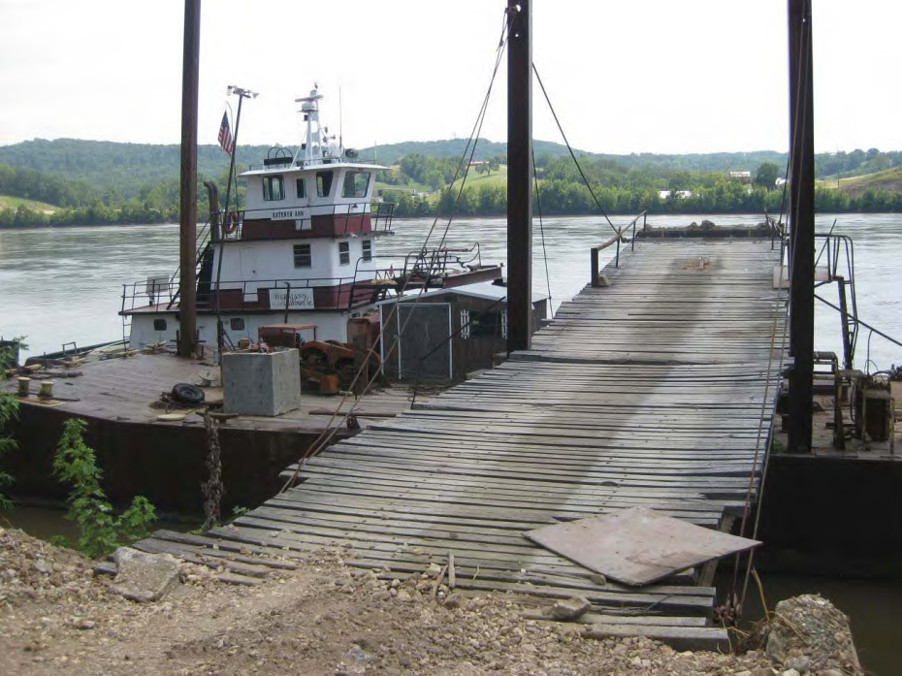
Thoughts:
What resiliency issues are regional?
What resiliency issues should be addressed regionally?
Other modes and issues is our region – interstate flooding, wind/storms, covid*.
*a good portion of recent funding, (approximately 80% of FEMA infrastructure funding) has been related to covid for last 5 years.

Slide 13
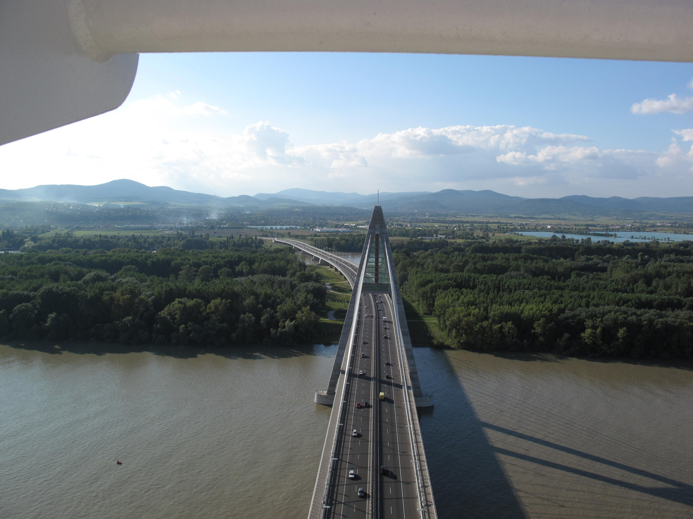
Thanks!
Ernie Perry, Ph.D.
ebperry@wisc.edu
608-890-2310

